Slide 1
Implementing the Policy Context for Onshore Wind Energy Development
Niall Cussen: Planning Regulator

Slide 2
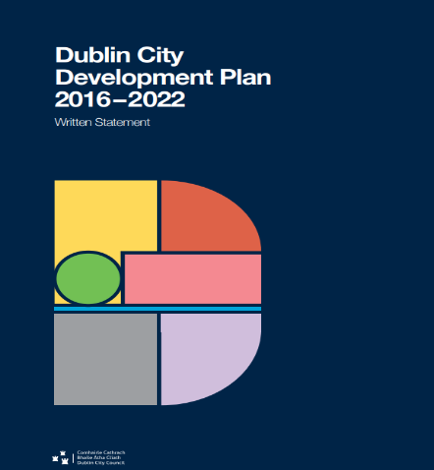
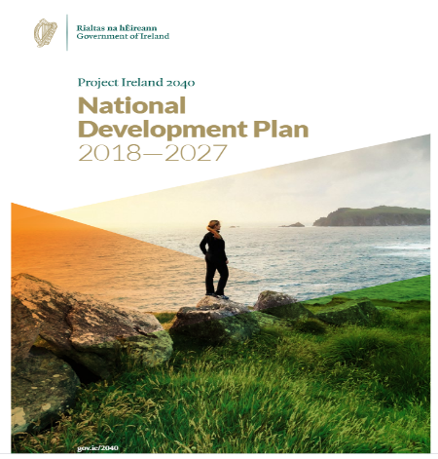
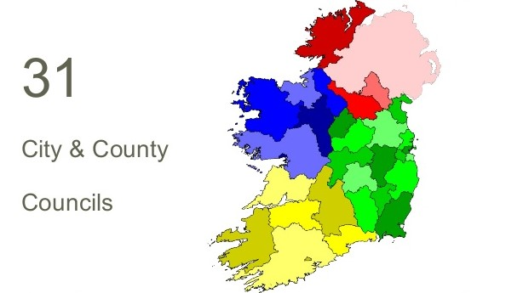



OPR functions
Assessment of statutory plans of local govt system for fit with statutory (Government/EU) policy and legislative requirements
Reviews and examinations of local authority and Bord Pleanála systems and procedures in the delivery of planning services to the public
Building knowledge and information base in planning through training for local authority members and staff, public information, research

Slide 3

Building Awareness
Research – Awareness – Training:
Our mandate: build public/institutional understanding
of benefits of good planning
HOW?
  Research: Use our networks to learn from others at EU+ levels
  Communications: Easy to access information: Eco-Eye/Planning Library
  Training: 939 councillors – over 500 members have attended OPR events so far.
Notes:
KEEEP …

Slide 4

Reviews of Planning Authorities
  The OPR can, at any time, or at the request of the Minister or on foot of a complaint, review systems and procedures used by all planning authorities, including An Bord Pleanála (S31AS/AT/AU)
  Strategy: Proactive rather than Reactive (complaints) approach - demonstrating broad functioning of PA’s and compare/contrast LA’s across sector + learnings…
  Programme: 2 in H2 2020, 4 in 2021, building to a programme whereby every planning authority is reviewed on a 6 year+cycle
  Methodology: Pilot methodology for conducting reviews - published in May 2020

Slide 5
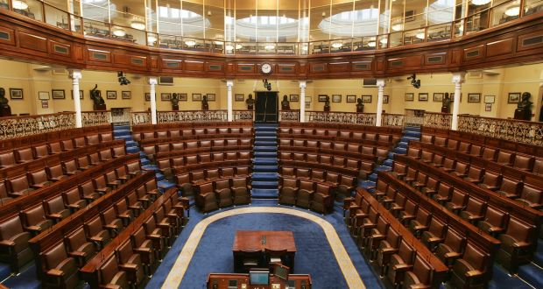
Assessment of Statutory Plans
S31AM(2) Planning and Development Act 2000 (as amended)
OPR must address legislative and policy matters relating to development plans:
  Requirements of Section 10 P&D Act (mandatory and discretionary objectives)
  Particularly – section 10(2)(n) in relation to Climate Change
  Consistency between the plan and the National Planning Framework - Regional Spatial and Economic Strategies (RSES)
  Minister (DHPLG) Guidelines – particularly Specific Planning Policy Requirements…e.g. Wind Energy Guidelines under Section 28 Planning Act
  Minister (DHPLG) Policy Directives (Section 29 Planning Act)
  Any legislative and policy matters the Minister may communicate to the Office

Slide 6
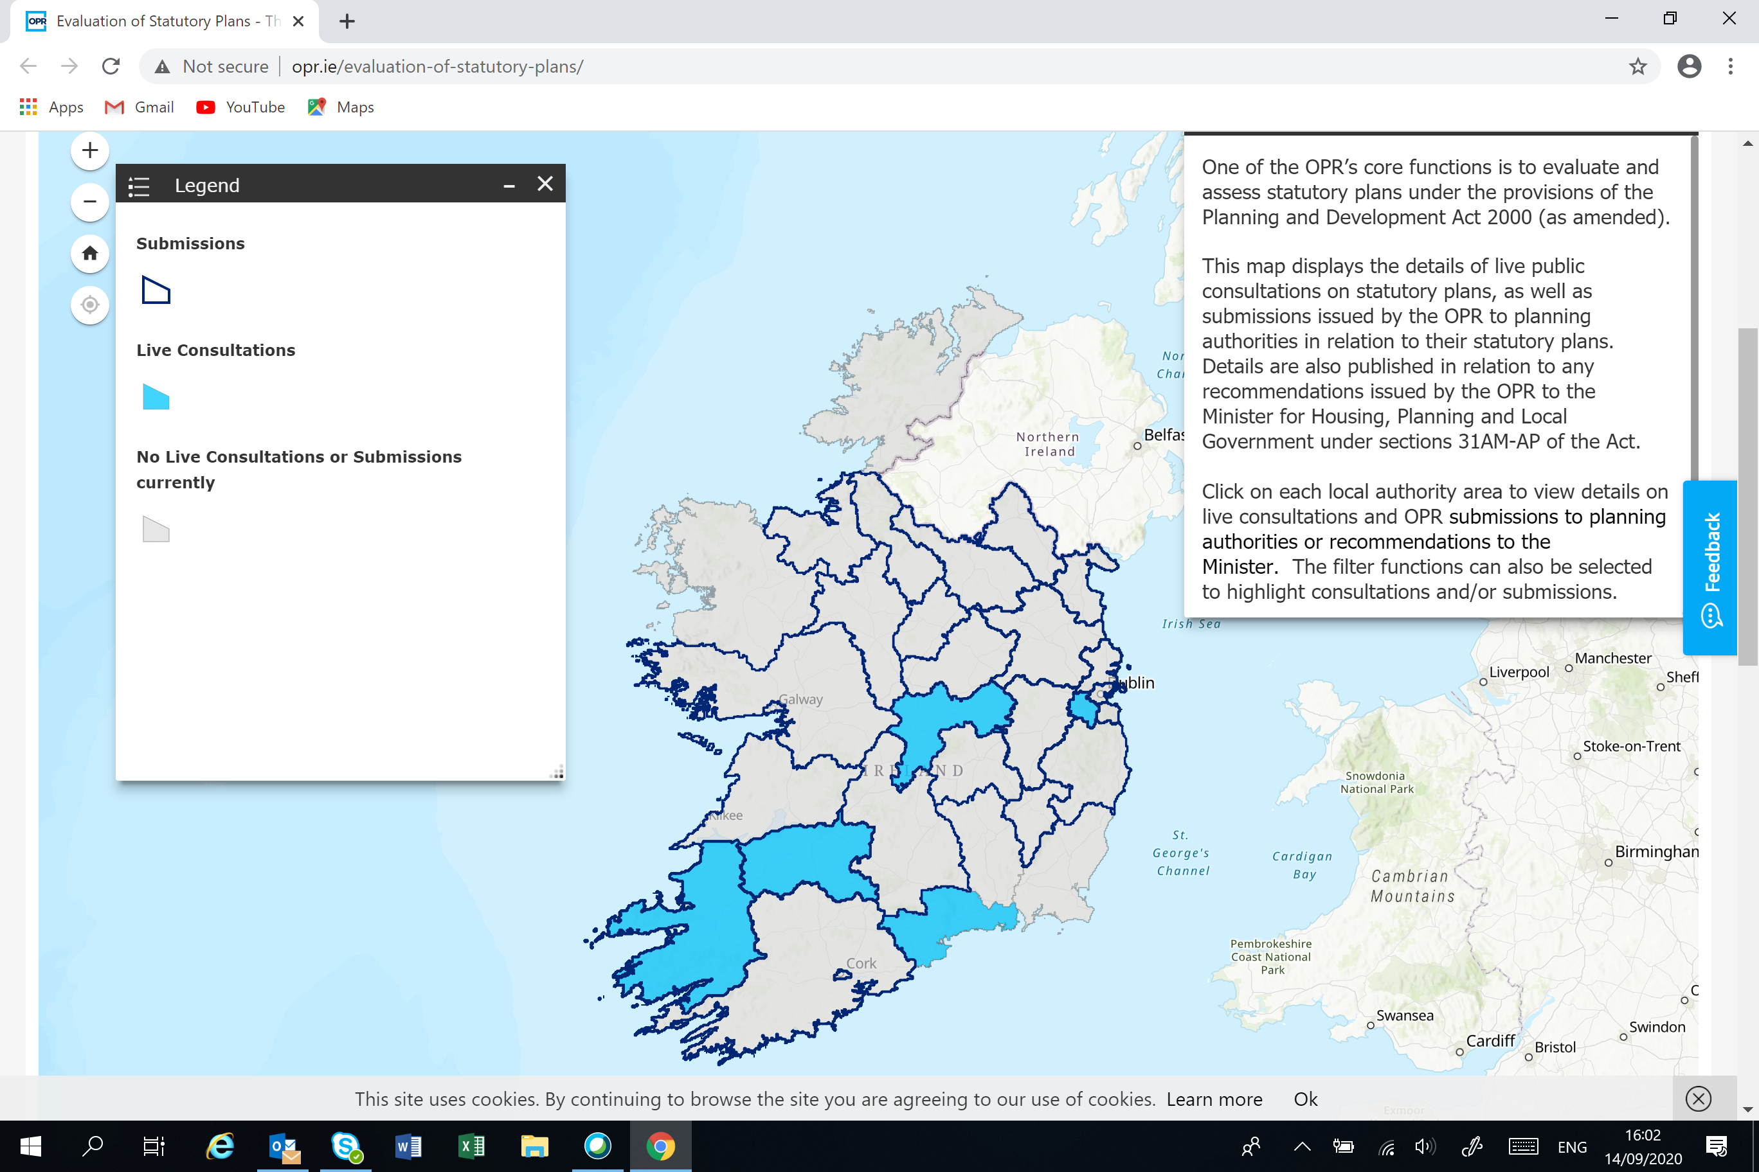
Interactive Tracker Live
  www.opr.ie
  Live info on plan reviews
  Access to OPR observations and recommendations
  Plan timeline/calendar tracker in development

Slide 7



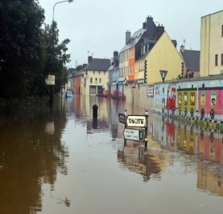
Climate and Assessment of Statutory Plans
OPR statutory assessments of plans will focus on practical
actions on climate change
Target areas for retrofit programmes in urban areas where energy efficiency/district heating solutions could enhance performance
Move away from objectives depending on car based mobility solutions and/or that are unlikely to be accessed primarily by sustainable travel modes…(calculating CO2 reductions)
Identify where/how renewable energy solutions can be rolled out in line with wider environmental considerations to go from 30% to 70% renewables…(analyse the potential)
Consider the potential for plans designating specific areas as carbon sinks – peatlands – forestry
Increase resilience of existing built-up areas and key infrastructure by stress-testing to extreme weather events…(flood/storm resilience)

Slide 8


  ALL LA Plans reviewed over next 2-3 years: Golden Opportunity
LA’s need clear policy on addressing climate issues in plan-making process – overseen by OPR Assessment:
Why?
  Ensure consistency across planning authorities
  Provide proper information and context for the public in participating in plan-making process
  Enable strategic assessment of all the environmental issues
  Establish a clear and fair basis for oversight by OPR (eg potential Directions)
  Deliver more certainty in planning outcomes for all
  What if plans fail to address climate appropriately?
  Recommendations to Minister to direct LA’s to re-do plans with respect to climate aspects??
  Stop-do not pass go scenario?

Slide 9
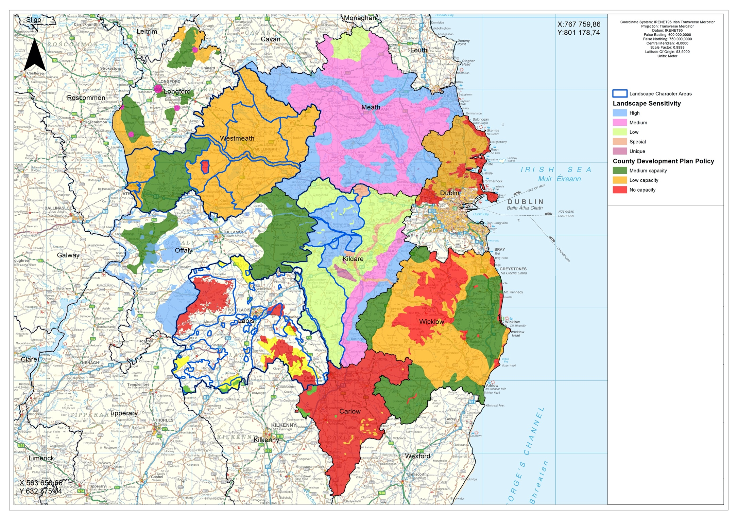
Next generation plans must avoid this…

Slide 10
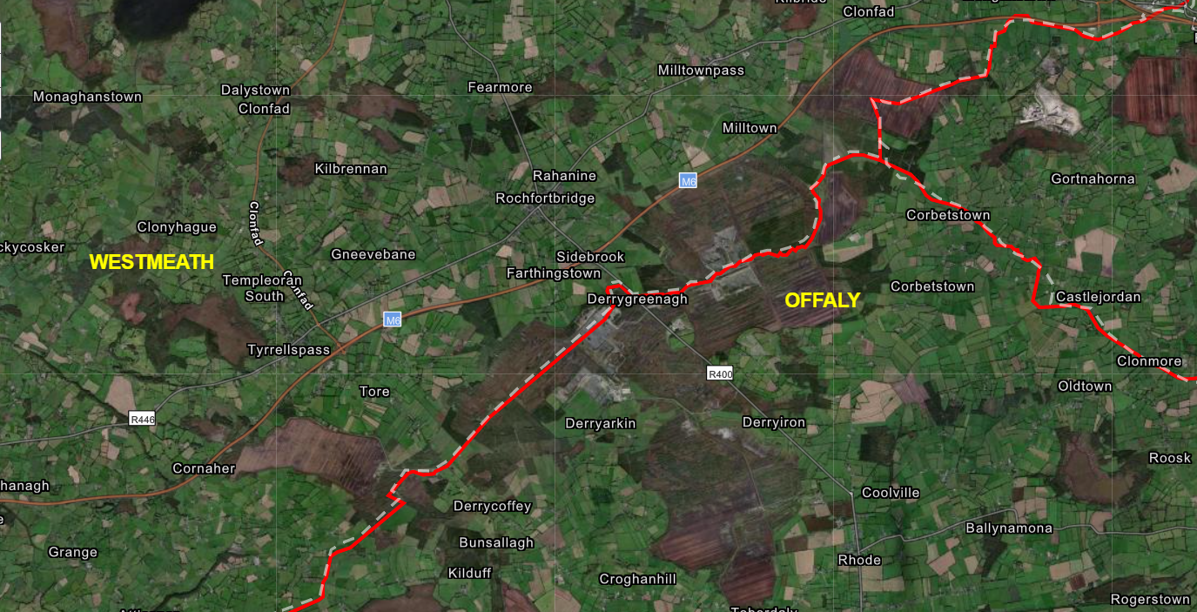
Really need to avoid this…

Slide 11
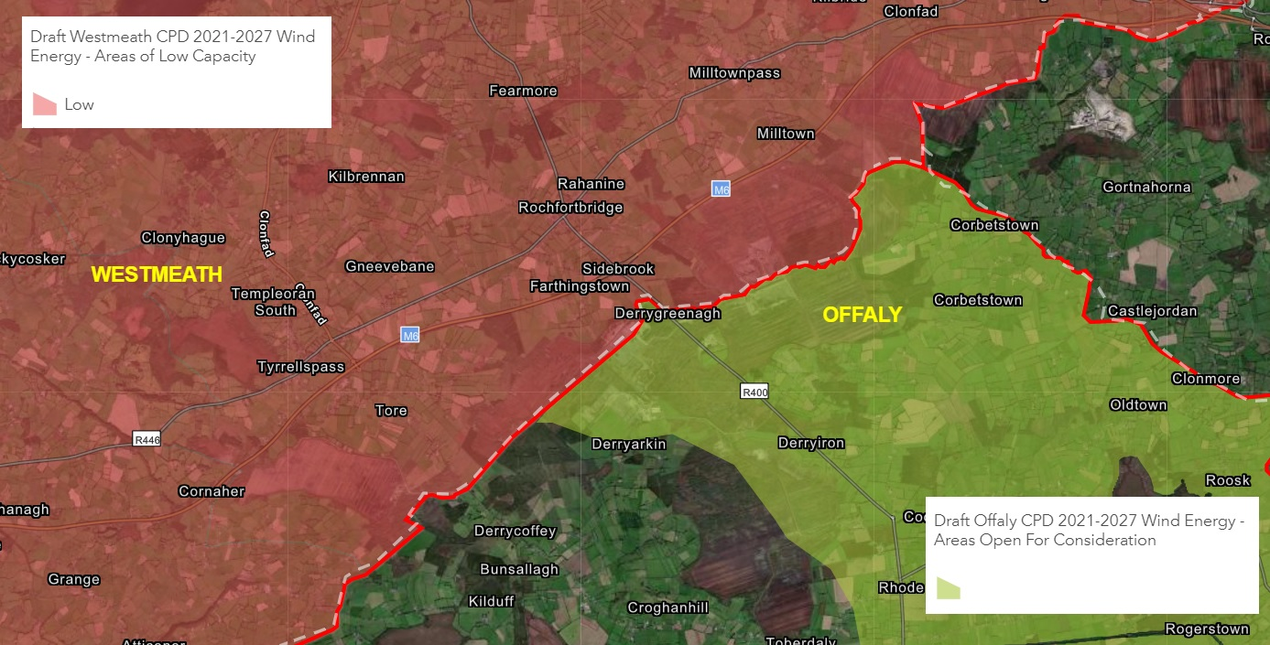

Slide 12

Summary of Current Position
Opportunities
Challenges
WEG’s review/REPDF ongoing
Translating national targets locally consistently needs maps
Climate Action Plan 2019: 70% renewable electricity by 2030
NPF/RSES’s
Need 4GW deliverable onshore - may require 15-20GW of land area for wind in development plans
Proper strategic info informs communities on options and timelines for delivering onshore/ offshore wind - solar
31 LA’s reviewing development plans - potential regional co-ordination – OPR oversight
OPR up and running but effectiveness will depend on effective & clear policy & maps

Slide 13
Could a Regionalised Approach Assist??
  3 x RSES’s have committed to regionalised approach…
  REPDF could additionally mandate…
  Climate Action Offices could assist development…
  Supports seamless approach across LA boundaries
  Inclusive of solar/marine/other renewable energies
  Public access to strategic information…
  Matter for Government…
Apply Regional Targets (3x6GW?)

Slide 14
What are the spatial options to meet 70% x 2030?
We need to be innovative & inclusive &
We need to move fast
Focus on practical
implementation
Engaging Communities
Co-ordinated Approach

Slide 15
Takeaways…
Planning system not broken!!!
Policy cascade is unclear
31xCDP reviews is golden opportunity – needs direction
OPR will uphold 70% x 30%
RE sector needs to proactively engage…
Potential regional co-ordination?

Slide 16
Thank You

