Slide 1
Environmental Impact Assessment
….and the changing nature of Planning
Anne Marie O’Connor
OPR Deputy Regulator
May 2020

Slide 2
Outline
Context: The changing role of development management planning
Key Differences between EIA and AA
The EIA Process
EIA Screening
EIA Evaluation by the competent authority
EIA Decision
Trends & Observations

Slide 3
Courts
PLANNING
Courts
EIA
AA
EIA
AA
EIA
AA
Courts
Courts

Slide 4
Some days…..
PLANNING
EIA/ AA

Slide 5
The Question?
What do we do now?

Slide 6
Need for a change of mindset
From this…
PLANNING
EIA
AA

Slide 7
……to this
General Planning Assessment
Appropriate Assessment
Environmental Impact Assessment

Slide 8
What is a ‘Planning Decision’?
Tests
Decision
Tripartite Decision
Proper Planning & Sustainable Development
Environmental Impact Assessment
Appropriate Assessment
‘On balance’
Reasoned Conclusion
Deterministic

Slide 9
Consequence for planning
Imperative that as planners we start to think about the ‘Planning Decision’ issued under the Planning and Development Act as three separate but interrelated entities

Slide 10
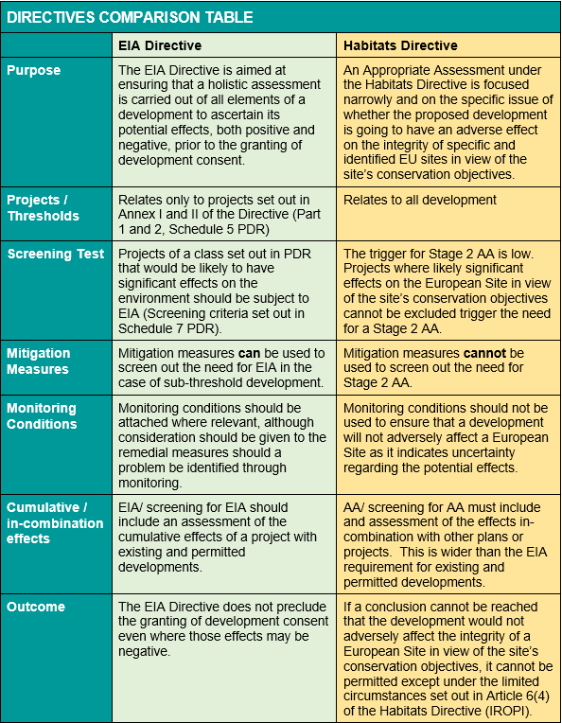
EIA Directive
-v-
Habitats Directive

Slide 11
Context - EIA Directive
Key Characteristics
‘Procedural’ Directive
Process – set out in the definition of the EIA Article 1(2)
Requirements of the process lead to quality decision making
Wider function of the EIA Directive to transpose conventions
Aarhus Convention
Right to access to environmental information (art 8a, 9)
Right to participate in environmental decision making (art 1(2), 6, 8)
Access to Justice on environmental matters (art 11)
Espoo Convention (Convention on EIA in a Transboundary Context) – art 7
Notes:
The Directive is procedural in nature, working on the basis that if the procedure for EIA is followed, then the likely significant effects will be identified, described and assessed, leading to high quality decision making. While the conclusion reached regarding the effects on the environment do not dictate the final decision, the reasons for the decision and basis upon which it was made must be clearly explained.

Slide 12
Definition of EIA Process
Article 1(2)
“environmental impact assessment” means a process consisting of:
(i) the preparation of an environmental impact assessment report by the developer,
(ii) the carrying out of consultations as referred to in Article 6 (and Article 7);
(iii) the examination by the competent authority of the information presented in the environmental impact assessment report and any supplementary information provided by the developer and any relevant information received through the consultations;
(iv) the reasoned conclusion by the competent authority on the significant effects of the project on the environment, taking into account the results of the examination referred to in point (iii) and, where appropriate, its own supplementary examination; and
(v) the integration of the competent authority's reasoned conclusion into any of the decisions referred to in Article 8a.
Notes:
(v) ‘Decisions’ - May be part of an integrated development consent procedure (ie planning permission/ environmental licence) or may be incorporated in another binding decision (ie standalone EIA decision)

Slide 13
Context - EIA Process
EIA Process
Screening
Scoping
EIA Report
Examination/ Evaluation
Decision
Monitoring
Consultation

Slide 14
EIA Screening
EIA Process
Screening
Scoping
EIA Report
Examination/ Evaluation
Decision
Monitoring
Consultation

Slide 15
EIA Screening
EIA Directive - Article 4
2014 Directive introduced new requirements in relation to screening for EIA, including issuing determinations as to whether sub-threshold development requires EIA (90 days)
2018 EIA Regulations - mandatory process for screening of all sub-threshold development
‘sub-threshold development’ means development of a type set out in Schedule 5 which does not exceed a quantity, area or other limit specified in that Schedule in respect of the relevant class of development (unchanged)
Schedule 5 PDR derives from Annex I and II Directive
- No change to list of projects
Schedule 5 (PDR) vs Annex I and II (Directive)
Notes:
Project – ie construction or intervention in natural environment - implications for material change of use where no works required

Slide 16
EIA Screening
Application Types
Screening applies to:
S.34 Applications and S.37 Appeals
S.5 Referrals (Exempt Development)
Strategic Housing Development
S 146B Amendments to Strategic Infrastructure/ Housing
Local Authority/ State Development
New direct applications for Screening Determination under s.176A
Notes:
Project – ie construction or intervention in natural environment - implications for material change of use where no works required

Slide 17
EIA Screening
Three steps to screening for EIA:
Pre-Screening
Is the development sub-threshold for EIA?
Preliminary Examination
Can likely significant effects on the environment be ruled out at a high level?
Screening Determination
Where further consideration is required to determine if there are likely significant effects that would require EIA and the submission of an EIAR

Slide 18
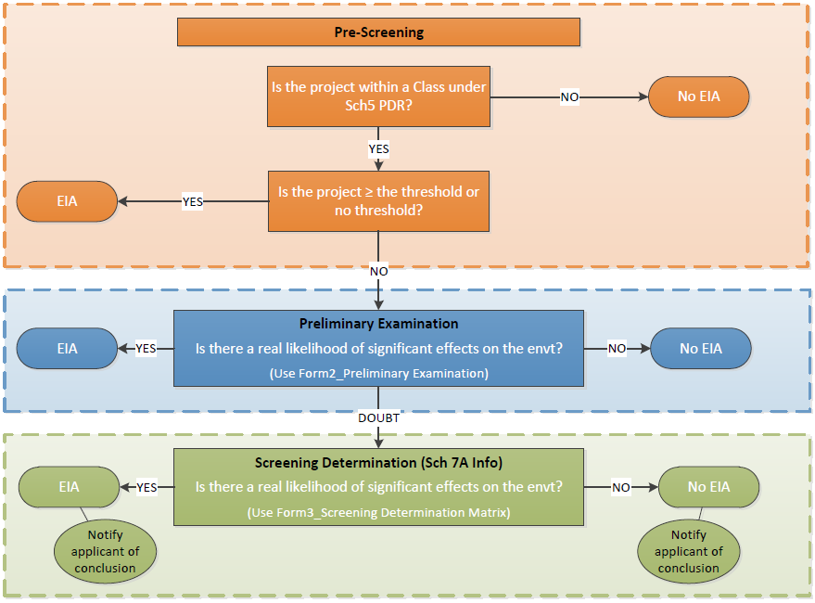

Slide 19
EIA Screening – Pre-screening

Slide 20
EIA Screening - Pre-screening
Developments excluded at Pre-screening
Change of use (no works) – not a project
Sheds, walls, landscape – not a class
Antennae – not a class
Shopfront – not a class
Signage – not a class
Solar Farms / Battery storage facilities – not a class (Sweetman v ABP IGP Solar, 2020)
The Brendan Slattery warning!!

Slide 21
EIA Screening – Pre-screening
Changes and Extensions – Mandatory EIA or Screening?
Part 1 Class 21
Any change to or extension of projects listed in this Annex where such a change or extension in itself meets the thresholds, if any, set out in this Annex.
Part 2 Class 13
(i) result in the development being of a class listed in Part 1 or Part 2 of this Schedule, (where the existing development has already been subject to EIA this first requirement is automatically met), and
(ii) result in an increase in size greater than 25%, or 50% of the threshold, whichever is the greater.

Slide 22
EIA Screening – Pre-screening
Changes and Extensions - Example
Quarry with an extracted area of 8ha that has previously been subject to EIA.
Mandatory threshold for any extension would be 2.5ha further extraction - ie 50% of the 5ha threshold for quarrying which, in this case, is greater than 25% of the existing extracted area (2ha).
BUT, less than 2.5ha requires screening - either preliminary examination or screening determination.
Fact that an EIA was previously carried out does not necessarily trigger an EIA for the extension, it just means that screening must be carried out.
Cumulative impacts must be taken into account in that screening.

Slide 23
EIA Screening
Considerations
Main purpose: To ensure that proposed developments likely to have significant effects on the environment are subject to EIA
Relationship with Habitats Directive/ AA
Link much stronger in 2014 EIA Directive
While the need for a Stage 2 AA does not necessarily trigger the need for EIA, consideration must be given to the likely significant effects on European Sites in screening for EIA
Mitigation measures!
Can be taken into account at screening for EIA
Extreme care in relation to any measures linked to European sites where NIS not submitted.
No public participation - but strict procedural rules and timelines

Slide 24
EIA Screening – Preliminary Examination

Slide 25
EIA Screening – Preliminary Examination
High-level screening to establish if the proposed development would be likely to have significant effects on the environment by virtue of the nature, size or location of the development.
Screen out cases based on:
Nature: where the development will not result in the production of any significant waste, or result in emissions or pollutants
Scale: limited size of the development – eg a single house
Location: location of the site removed from any sensitive locations or features or the absence of a pathway to any sensitive location in the vicinity

Slide 26
EIA Screening - Preliminary Examination
Conclusion (examples)
Screening Determination not required (no issues)
Having regard to the limited nature and scale of the proposed development and the absence of any significant environmental sensitivity in the vicinity/ the absence of any connectivity to any sensitive location, there is no real likelihood of significant effects on the environment arising from the proposed development. The need for environmental impact assessment can, therefore, be excluded at preliminary examination and a screening determination is not required.
Screening Determination not required (AA issues)
Having regard to the nature and scale of the proposed development it is considered that the issues arising from the proximity/ connectivity to European Sites can be adequately dealt with under the Habitats Directive (Appropriate Assessment) as there is no likelihood of other significant effects on the environment. The need for environmental impact assessment can, therefore, be excluded at preliminary examination and a screening determination is not required.

Slide 27
EIA Screening – Screening Determination

Slide 28
EIA Screening – Screening Determination
A Screening Determination must be carried out if there is significant and realistic doubt in regard to the likelihood of significant effects on the environment arising from the proposed development.
Requirement for Schedule 7A information to be submitted by applicant to form basis for the screening determination
The conclusion of the screening determination must be notified to the applicant within 8 weeks of receipt of the Schedule 7A information.

Slide 29
EIA Screening - Screening Determination
Schedule 7A Information (1)
Schedule 7A information is the information that needs to be submitted by the applicant to inform the PA/Board in deciding whether an EIAR is required. It comprises:
A description of the proposed development
A description of the aspects of the environment likely to be significantly affected by the proposed development.
A description of any likely significant effects of the proposed development on the environment.
Where relevant, accompanied by:
The results of any other relevant assessment (eg SEA)

Slide 30
EIA Screening - Screening Determination
Schedule 7A Information (2)
Applicant may also submit:
‘Mitigation Measures’ - a description of any features or measures envisaged to avoid or prevent a significant adverse effect on the environment, and these may be taken into account when determining whether an EIAR is required
When is Schedule 7A information actually Schedule 7A information?
ABP approach: Can be presented as a separate EIA screening report so long as it is clear that the information relates to Schedule 7A of the PDR (as amended).

Slide 31
EIA Screening - Screening Determination
Should be carried out in accordance with the criteria set out in Schedule 7 P&D Regs:
Characteristics of proposed development
Location of proposed development
Types and characteristics of potential impacts
The conclusion itself should be similar to the reasons and consideration for other decisions setting out:
the matters which were had regard to (as set out in article 103 or article 109)
details of the characteristics of the development and sensitivity of the location
description of any likely significant effects on the environment (if any)
details of any features or measures envisaged to avoid or prevent a significant adverse effect on the environment proposed by the applicant, which were taken into account (if relevant)

Slide 32
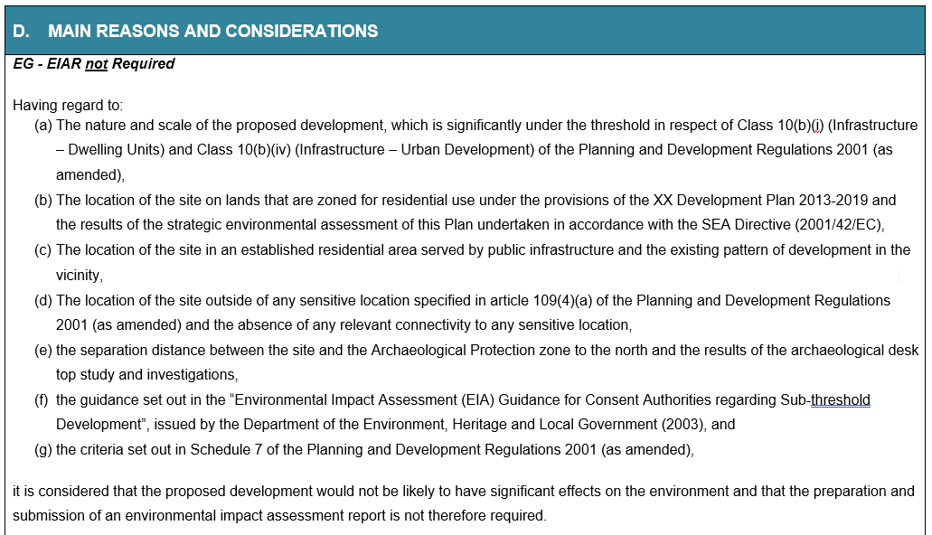

Slide 33
EIA Screening – Issues (1)
Project Splitting
Recent example of 3 adjoining housing applications
Where development is part of a Masterplan
No project splitting arises if each part of the masterplan development is subject to the EIA Directive (in terms of screening and/ or assessment).
Screening must consider the effects of the proposed development cumulatively with other relevant development, especially existing or permitted elements of the masterplan.
Example – Masterplan for urban mixed use development including 600 houses. Phase One for 200 houses must be subject to screening (as sub-threshold) but may be screened out if not considered to result in likely significant effects in the knowledge that the cumulative effects of Phase One will be considered once the masterplan build out reaches the point where the screening for EIA determines that the proposed development is likely to result in significant effects on the environment..
Apple Data centre – Fitzpatrick v ABP [2017] IEHC 585

Slide 34
EIA Screening – Issues (2)
Indirect Effects
Inputs to the development (peat fuel source, utilities, infrastructure requirements), and
Outputs from the development (electricity outputs, land-spreading associated with agricultural installations, wastes etc).
Edenderry Peat burning power plant - An Taisce v ABP [2015] IEHC 633
Extension of time
Wells (C‑201/02) - A decision which is necessary to prevent an existing development consent from expiring constitutes a new development consent within the meaning of the EIA Directive.
Section 42 P&D Act

Slide 35
Examination by Competent Authority
EIA Process
Screening
Scoping
EIA Report
Examination/ Evaluation
Decision
Monitoring
Consultation

Slide 36
EIA - Reasoned Conclusion
The means by which the competent authority finalises its examination of the environmental impact of the project (Preamble 21)
Limited to main significant effects, not all effects
Specify the main significant direct, indirect and cumulative effects and how/ if these will be mitigated
Must be up to date when the decision to grant development consent is made
Must be integrated into the Decision to Grant or Refuse permission.

Slide 37
EIA - Reasoned Conclusion
Examples
301522 (Residential scheme) – landscape, cultural heritage, noise and vibration (construction), air (construction), water (surface water management).
301908 (Wastewater treatment) – population & human health (positive and negative), marine, bathing and general water quality, flooding, marine biodiversity, birds, traffic.
09.JA0042 (Flood relief scheme) – noise and vibration (construction), traffic (construction), biodiversity (construction), cultural heritage, landscape, land (positive impacts).
09.JA0041 (Landfill remediation) – air and noise (construction), ground and surface water (construction), biodiversity, traffic, archaeology.
303086 (Wind farm) – human health (shadow flicker), biodiversity, land & soil (peat), water, landscape and visual impact, noise and vibration.

Slide 38
Examination by Competent Authority
EIA Process
Screening
Scoping
EIA Report
Examination/ Evaluation
Decision
Monitoring
Consultation

Slide 39
EIA – Content of Decision

Slide 40
EIA – Decision
Where PA/ Board agrees with the evaluation in the planner/ inspector’s report, it can adopt in full
Where PA/ Board disagrees in part or in full with the evaluation/ reasoned conclusion in the planner/ inspector’s report the PA/ Board’s reasons and own considerations in this regard must be reasoned and recorded.
Reasons must be given for materially altering or omitting an environmental condition in the planner/ Inspector’s report

Slide 41
Trends and Observations - Screening
Insufficient consideration given to whether proposal constitutes a sub-threshold development - Is it of a Class?
Confusion regarding extensions and alterations (Class 13)
Relatively few appeal cases in ‘screening determination’ – either EIAR submitted or ruled out at Preliminary Examination – exception being piggeries and waste facilities
Abundance of caution – Are EIAR being prepared when the proposed development could be screened out?
Requirement for AA does not trigger EIA!

Slide 42
Trends and Observations – Evaluation & Decision
Planner Reports
Inconsistency in approach to Reasoned Conclusion & legislative requirements
Absence of Reasoned Conclusion
Planning Authority Notification of Decision
No change to reflect requirements of 2018 Regulations
Reasoned Conclusion not integrated into the Decision
Reasons not given for materially altering or not accepting conditions/ recommendation in planner’s report.

Slide 43
Questions and Discussion

