Slide 1
Urban Regeneration and Place Making
Niall Cussen: Planning Regulator

Slide 2
Adapting to the new normal
Post May 5th
Urban Regeneration and Place
Making Post Covid-19
We will be adopting a “new normal”
in living/working post COVID 19
Will be a key part of national recovery
Likely to benefit from government commitments to protect investment
Events of the past months have proven our ability to adapt
Will harness growing momentum in regeneration activities post NDP/NPF
Virtual /e-training activities
are essential in adaption
Government sees the planning profession as central to making
things happen

Slide 3
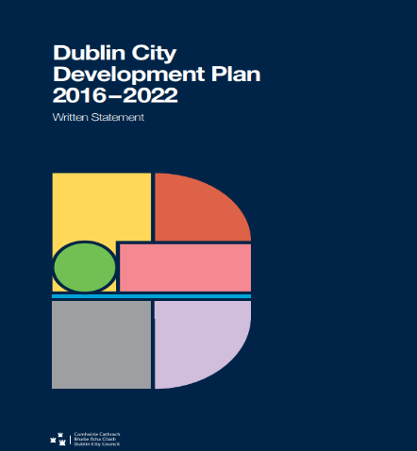
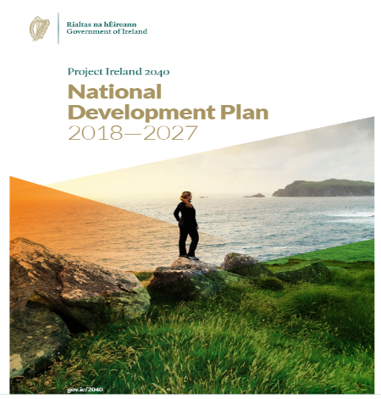
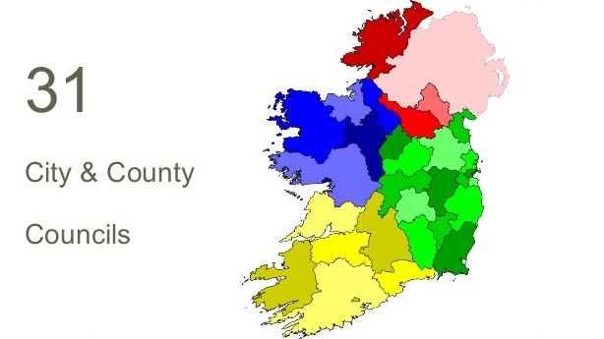
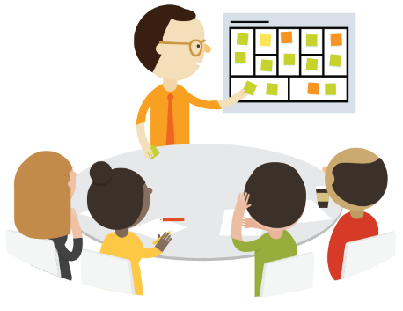
Today and OPR Functions
Assessment of statutory plans of local govt system for fit with statutory (Government/EU) policy and legislative requirements
Reviews and examinations of local authority and An Bord Pleanála systems and procedures in the delivery of planning services to the public
Building knowledge and information base in planning through training for local authority members and staff, public information, research

Slide 4
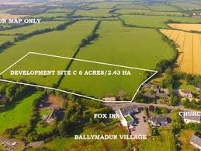
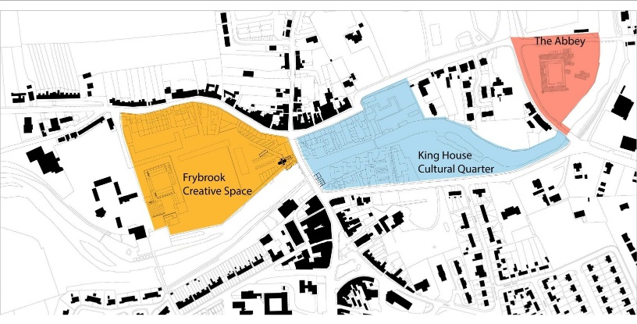
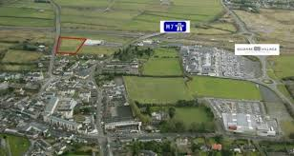
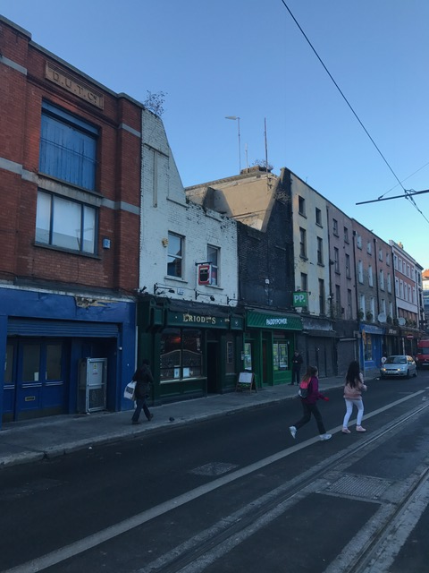
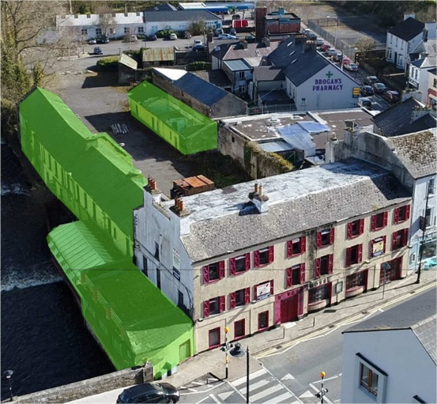
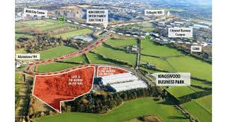
“Old” Planning?
Planning Today?

Slide 5
New Tools for New Tasks…
Understanding the requirements of Government mechanisms (URDF +)
….Preparing and implementing Urban
Regeneration and Place-Making Strategies
requires new attitudes, knowledge and
skills …..
Thinking ahead to new challenges (town centres & retail post CV19
Upskilling on “harder” economic and delivery skills
Creating a consensus – optioneering – managing the political minefield
Public awareness building – benefits/trade-offs in 1st class regeneration
and urban design

Slide 6
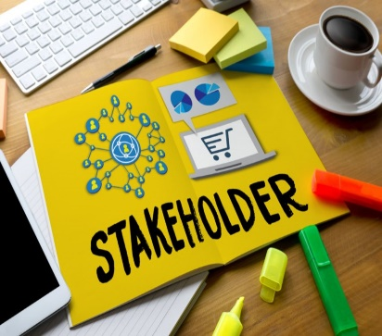
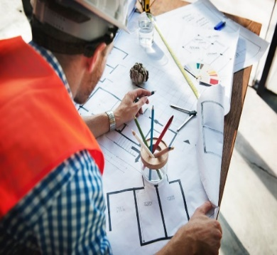
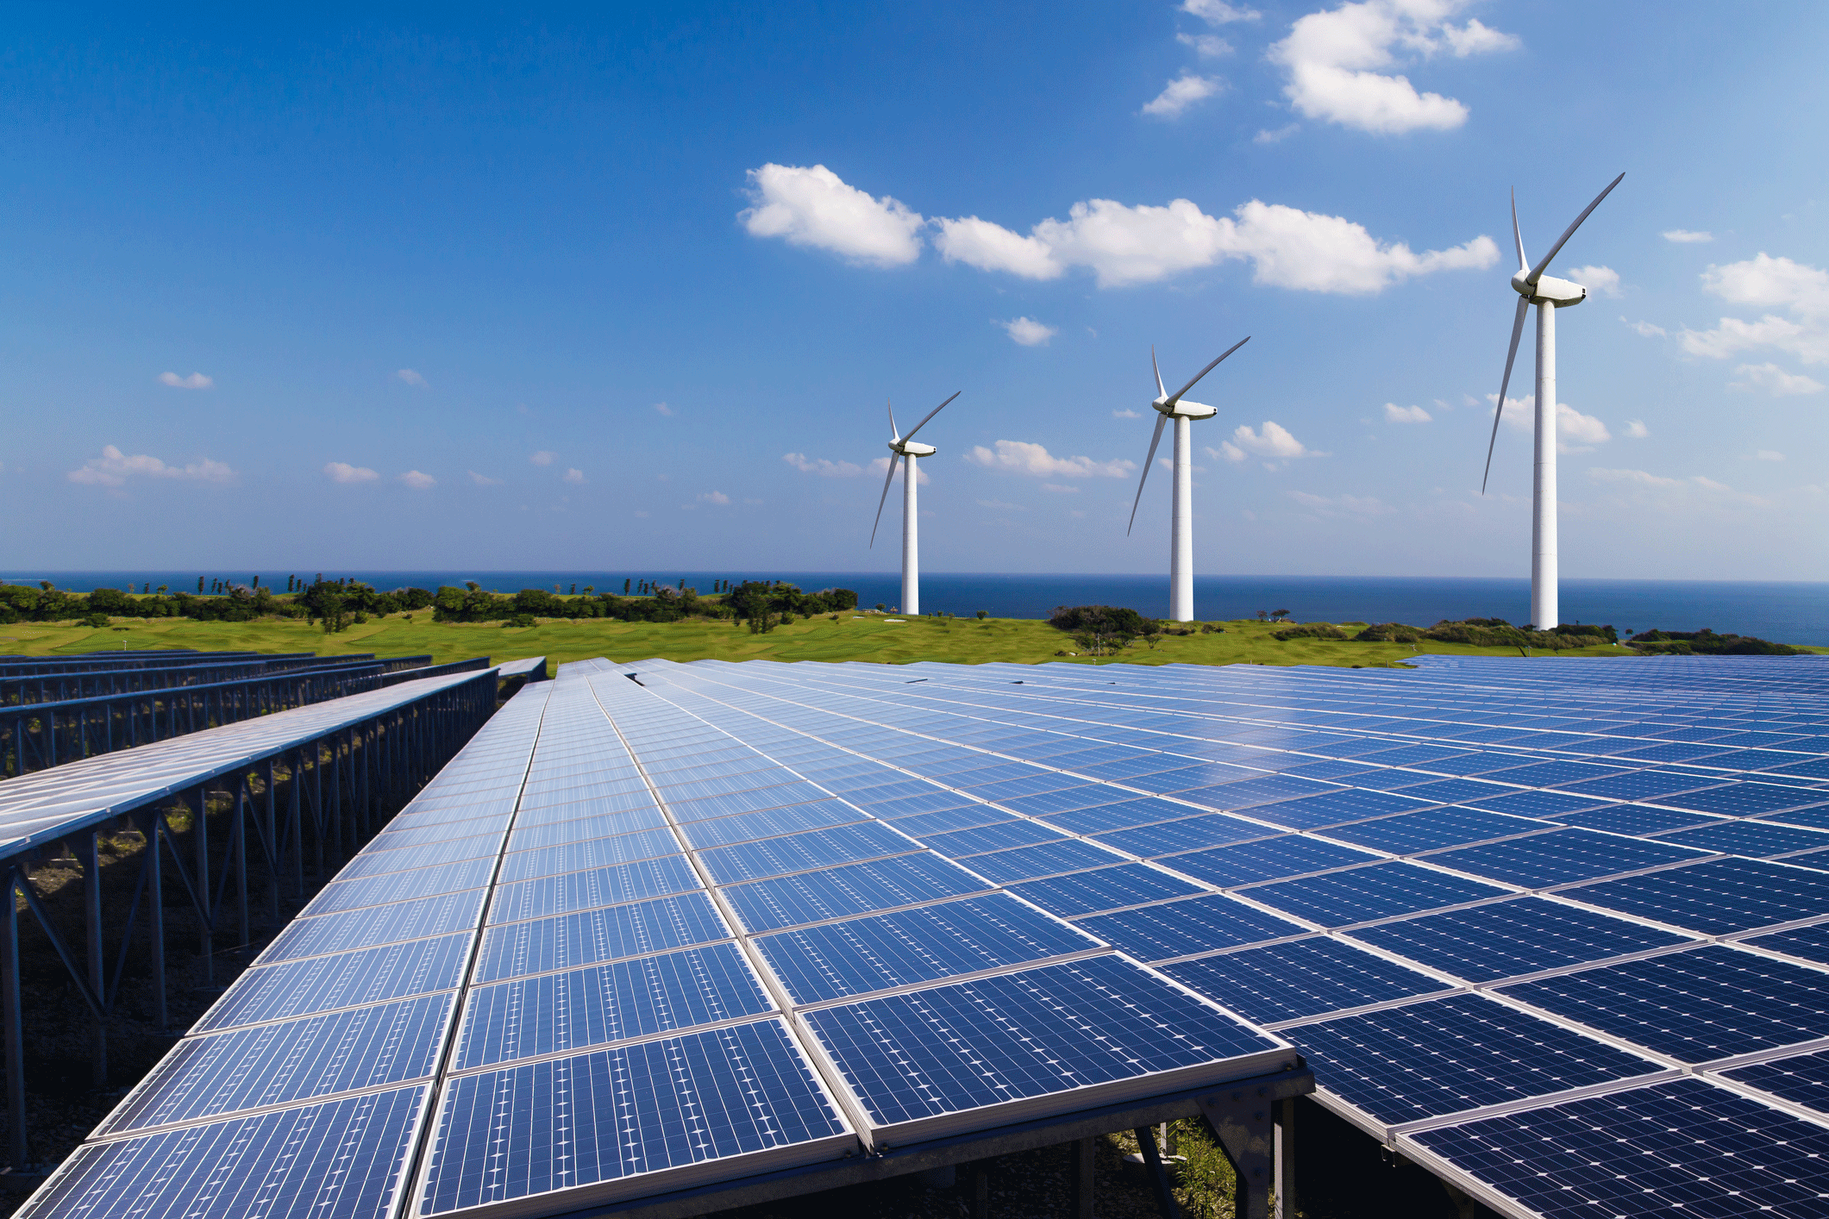
Urban Regeneration and Place-Making
Some practical areas for professional development…
Business Skills: Real estate Viability and economic appraisal – Procurement – Project Management
People Skills: Stakeholder engagement – Participative policy Development – Consensus building
Planning Skills: Sustainable mobility implementation – Urban block modelling - 3D Visualisation – Assessment of intervention impacts
Sustainability Skills: - Carbon neutral development – Green energy – Circular economy – Biodiversity and green networks
Notes:
Last Box…’Increase resilience of existing built-up areas and key infrastructure by stress-testing to extreme weather events…(flood/storm resilience) ‘
Leads into next slide…. Resilience building..

Slide 7
OPR is here to…
Communicate
Participate
Co-operate

