Slide 1
IHBA/CIF Regional Seminars
Briefing on The Office of the Planning Regulator
Niall Cussen: Chief Executive and Planning Regulator

Slide 2
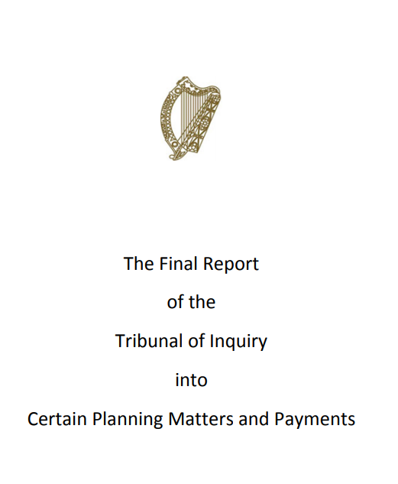
Purpose of the OPR
Implementation of key recommendation of Mahon Tribunal to strengthen independent oversight of the planning process through…

Slide 3
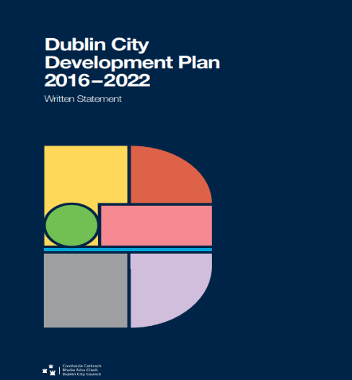
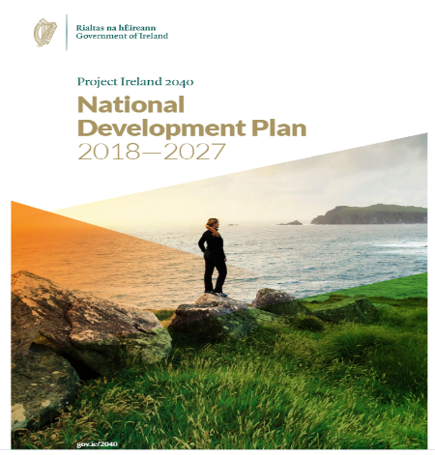
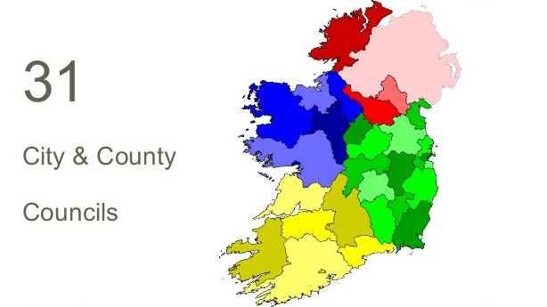
Three main functions
Assessment of statutory plans of local govt system for fit with statutory (Government/EU) policy and legislative requirements
Reviews and examinations of local authority and Bord Pleanála systems and procedures in the delivery of planning services to the public
Building knowledge and information base in planning through training for local authority members and staff, public information, research

Slide 4
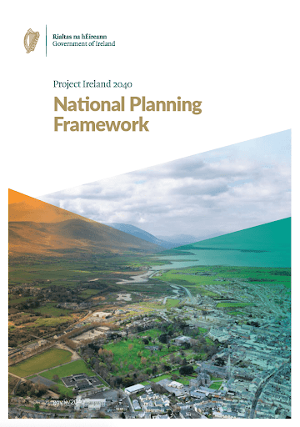
Assessment of Statutory Plans
OPR will evaluate local authority/regional assembly plans at strategic level
Pre-plan making stage
(issues papers)
Draft plan/
amended draft stages
FOCUS
Consistency with National Planning Framework (Brownfield Targets)
Regional Spatial and Economic Strategies
Guidelines and Directives issued by Minister
Climate change
OPR is developing – with stakeholders – an objective plans assessment methodology

Slide 5
Reviews of Planning Authorities
OPR can at any time or at request of the Minister or on foot of complaints, review systems and procedures used by all planning authorities, including An Bord Pleanála
Methodology: almost finalised – to be published shortly
Reviews: first two to be done this year, four next year, building to a programme whereby every planning authority is reviewed on a six year+cycle
Review process will be an important resource for the planning sector

Slide 6
Research & Public Awareness
Statutory mandate to conduct education, research and training programs
Training: for elected members and officials – four events: attended by over 500 members to date
Research: into matters relevant to the OPR’s functions or at the request of the Minister
National Planning Knowledge Group established & considering topics - eg
Assessment of climate impacts in forward planning decisions
GIS tools to assist forward planning
We want people to engage more with the planning process, so we’re doing things like this……..

Slide 7
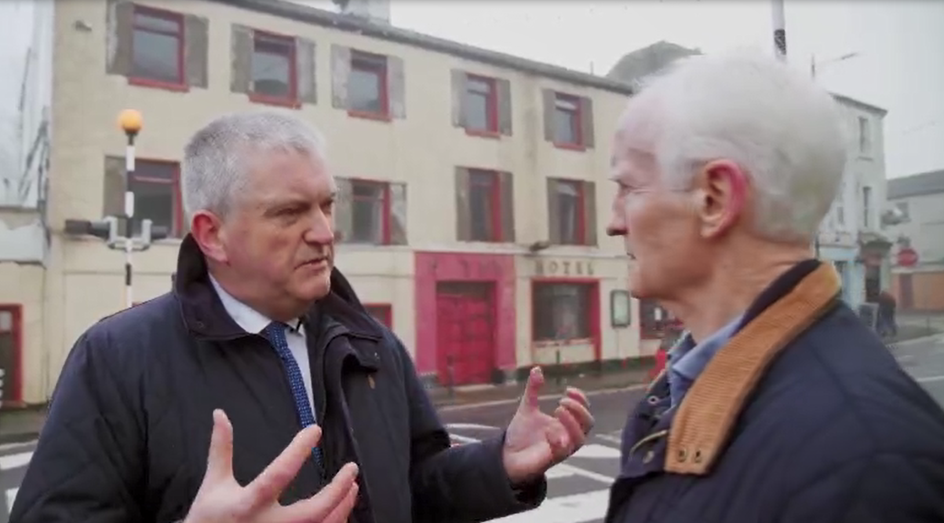
Eco-Eye, RTE 1 January 2020

Slide 8
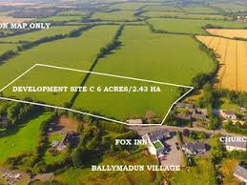
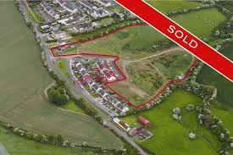
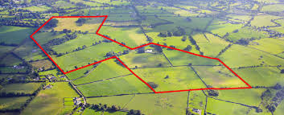
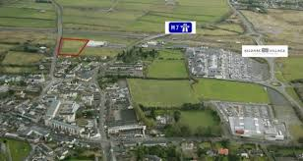
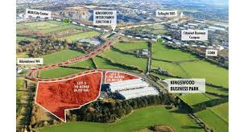
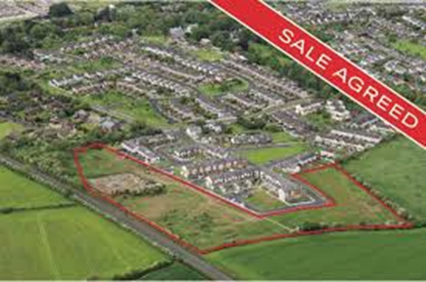
Plan-making isn’t a “numbers” exercise

Slide 9
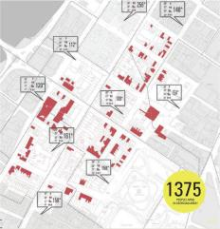
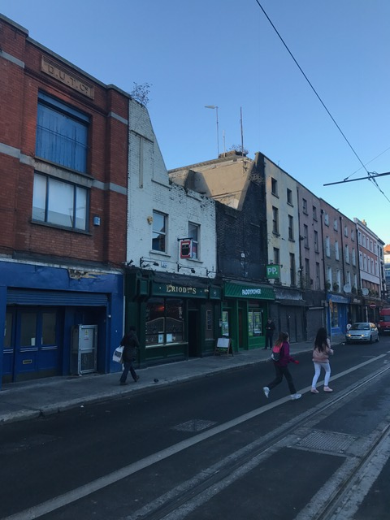
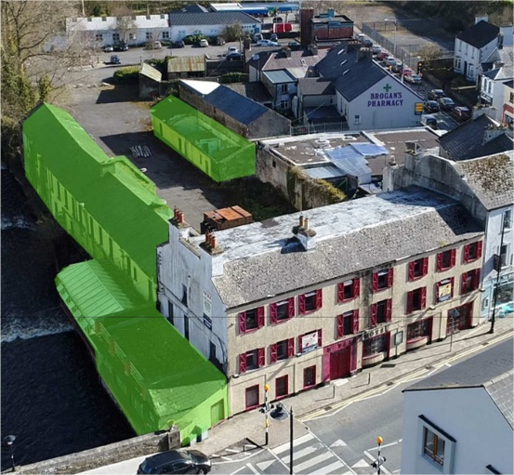
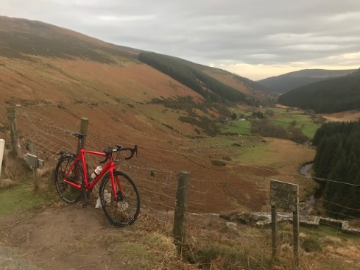
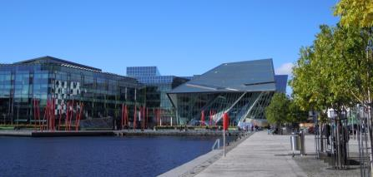
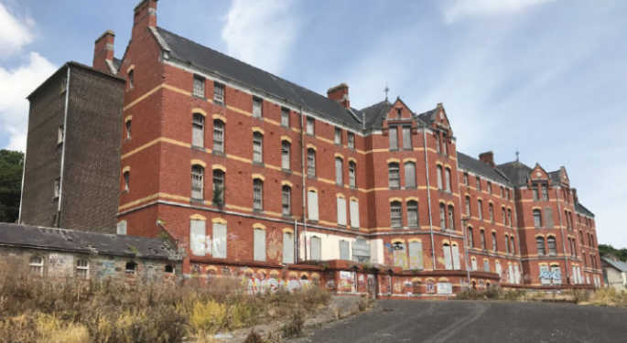
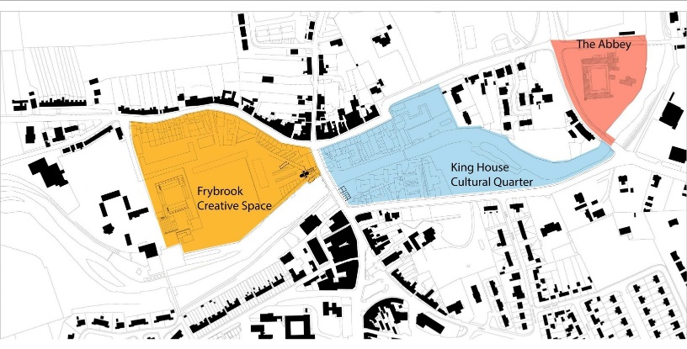
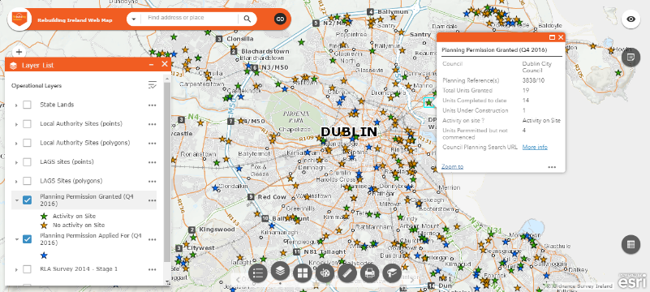
It’s about place-making – focus
on certainty and deliverability

Slide 10
OPR plan-making recommendations ensure…
The OPR recommends that your authority includes
objectives for appropriate phased development of new or future development areas, with the areas located closest to the town centre and or with infrastructure capacity identified for the first phases, and areas that will require the resolution of particular infrastructural constraints identified for development phases in the medium or longer term
Draft Leixlip Local Area Plan 2020-2026
Best practice
followed

Slide 11
The OPR pointed out that a sequential approach to the zoning of lands was required under Planning Guideline Planning Authorities on the Preparation of Development Plans, 2007
Draft Listowel Municipal Local Area Plan 2019-2025
Consistency with guidelines
The OPR recommends that the planning authority comprehensively demonstrate that the Draft LAP complies with the requirements of the Spatial Planning and National Roads Guidelines (2012) and in particular the requirement of section 2.4 for detailed transport modelling/analysis.
Draft Naas local area plan 2019-2023

Slide 12
The OPR commends the council for the strong emphasis on the need to tackle climate change, support green infrastructure and biodiversity and for its achievements in these areas.
Issues Paper for the Dun Laoghaire Rathdown County Development Plan 2022 – 2028
Good planning
recognised
The OPR would be supportive of the regeneration of this brownfield site which would accommodate new more intensive development…. Such an approach would be in accordance with established national planning objectives…Accordingly, the Office broadly supports the proposed variation and urges your authority to finalise same.
Proposed Variation No. 6 of the Cork City Development Plan 2015-2021

Slide 13
In conclusion, the OPR is here to…
Collaborate
Inform
Co-operate

