Slide 1
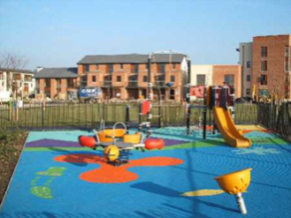
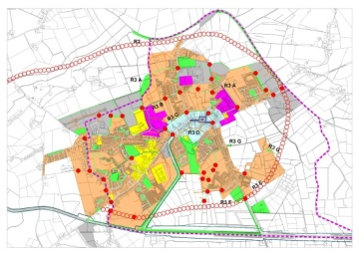
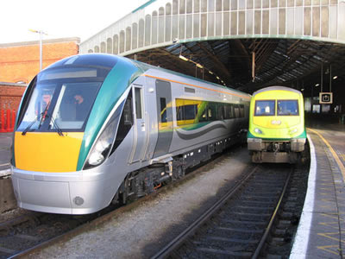
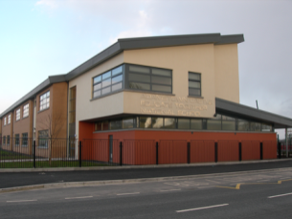
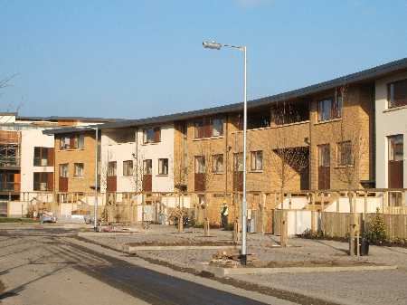
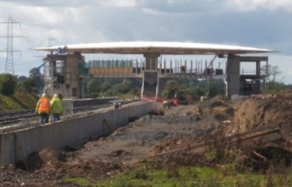
Ireland’s Planning Process Fit for purpose?
Niall Cussen F.I.P.I Planning Regulator

Slide 2
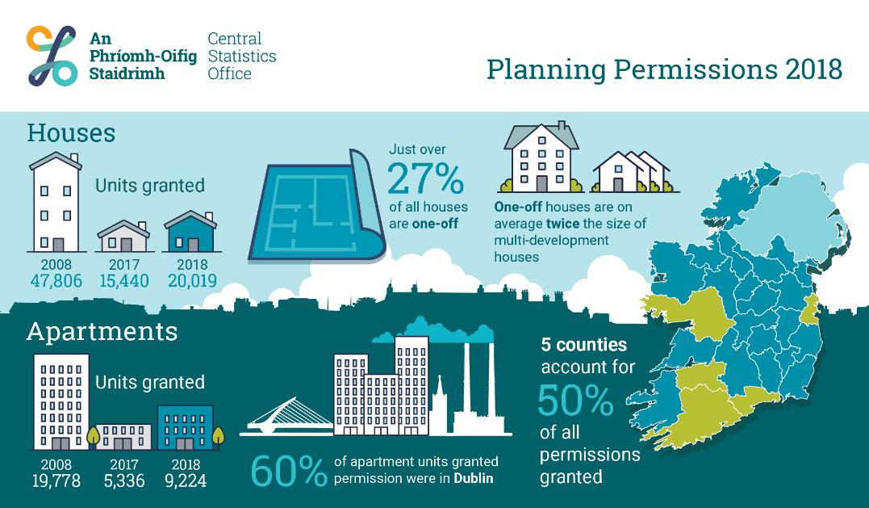
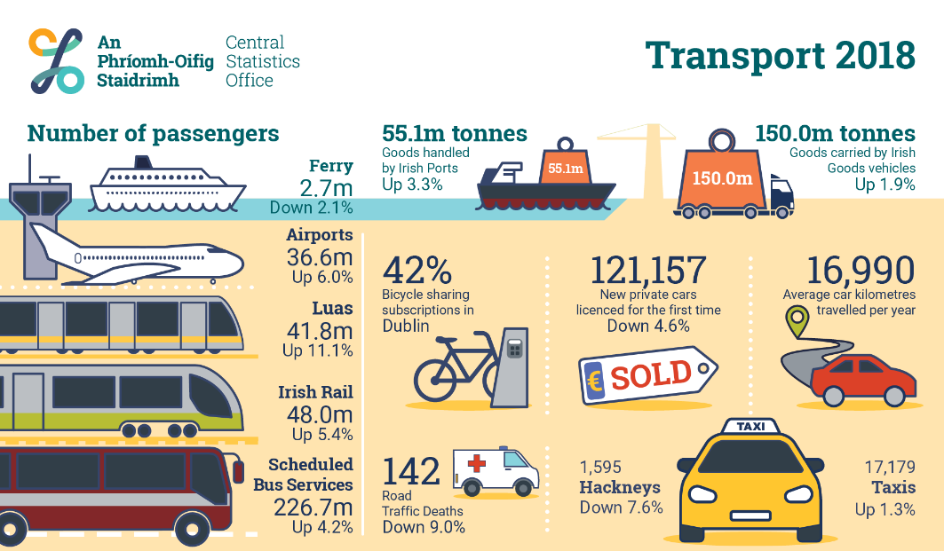
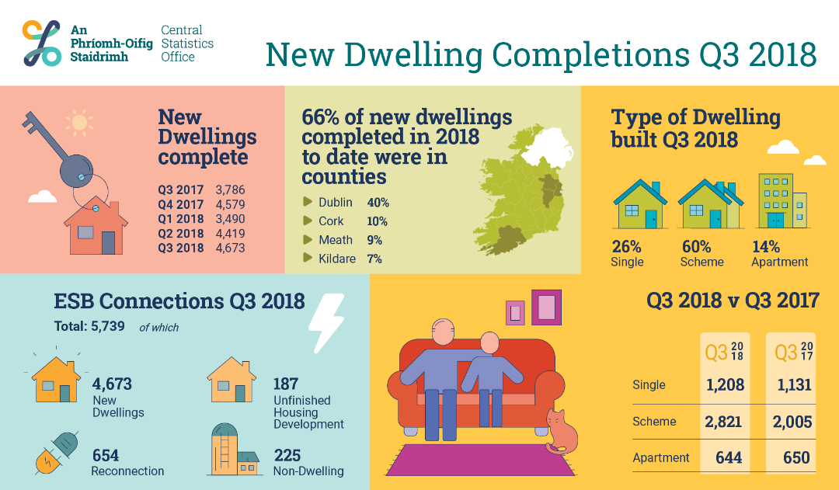
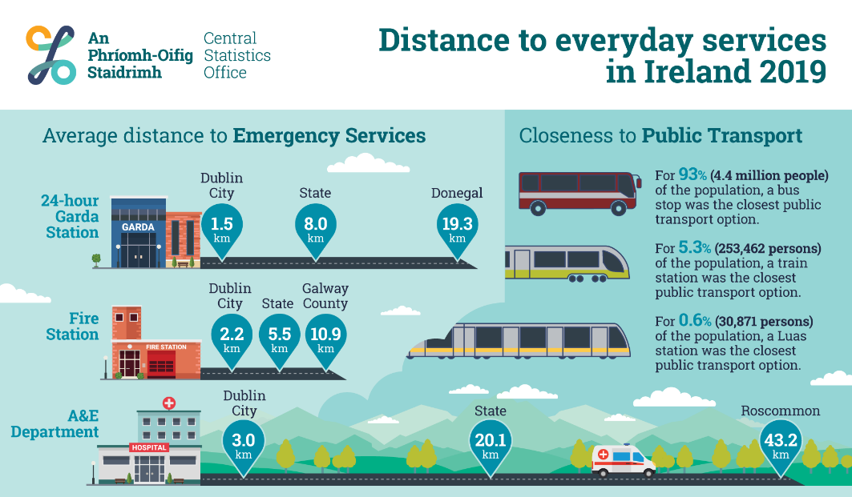
Planning is Key!

Slide 3
Then and Now
1990’s | 2019+
No national planning framework | NPF (2018)
No regional planning | Regional Spatial and Economic Strategies (2019)
Planning and Development Act 1963 (as amended) | Planning and Development Act 2000 (as amended) 944 amendments since 2000 (??!!)
Few EU Directives impacting directly on Planning (EIA) | EIA, SEA, Habitats, WFD, Noise, Public Participation, Services, Aarhus, etc……….
Key Challenges: Economic development?? | Sustainable development, environmental protection, climate adaptation (flood protection) and emissions reduction (smarter travel etc), housing delivery, rational delivery of public services
1x statutory planning guidelines | >30 Ministerial Guidelines and Directives
88 planning authorities – ABP | 31 planning authorities – 3 regional assemblies – ABP – EPA – Land Development Agency
Judicial reviews of planning decisions (?) | 150+ JR’s on planning related matters?? S50B

Slide 4
Planning
in Ireland
31
3
P l a n n i n g
A u t h o r i t i e s
R e g i o n a l
A s s e m b l i e s
1
200+
Statutory Development Plans Local Area Plans
Strategic Development Zones
Plaft
A n B o r d P l e a n á l a
200+
2018 i n N u m b e r s
24%
23%
Decision conf irmed
25,883
applications granted
Appeals to
2,028
Decision reversed
28,785
Planning decisions made
An Bord Pleanála
53%
Decision Varied
2,902
applications refused

Slide 5
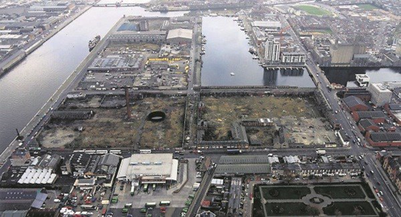
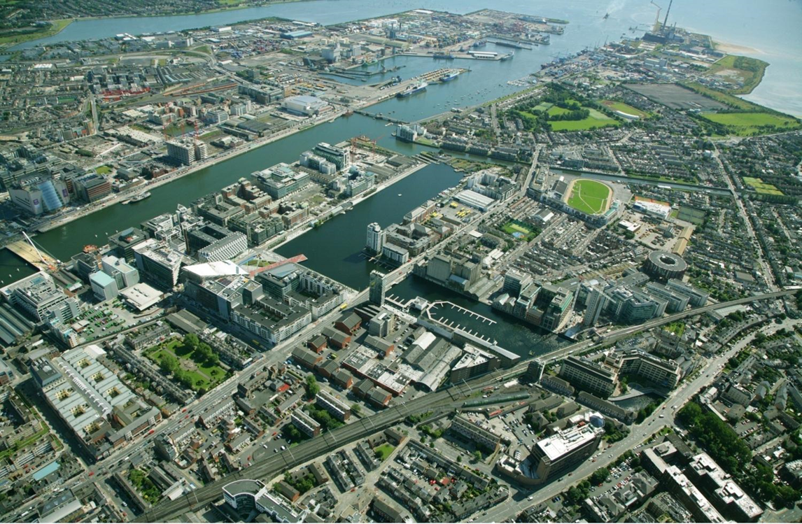
Strengths
Resurgent economy
Strong Government support for planning
€116bn National Development Plan backed NPF
Regularly updated city/county/local plans
Well developed consent regimes (SID/SHD)
Greater public engagement in planning
Broadened local authority functions
Better oversight

Slide 6
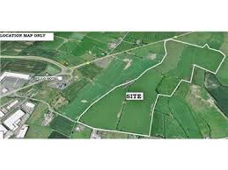
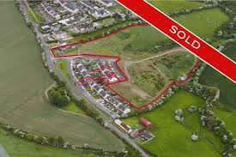
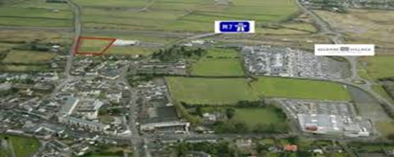
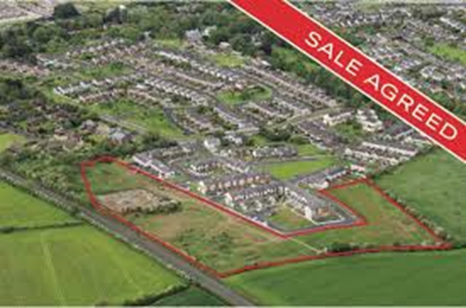
Weaknesses
Traditionally not well linked to capital investment programmes
Edge vs town centre development
Land management levers weak (but LDA, Vacant Sites etc may change)
Public engagement tends to project stages (increased litigation – 150JR’s)
Broadened scope vs skills deficits (land activation – environment and planning - enforcement)
Analysis/data on planning outcomes

Slide 7
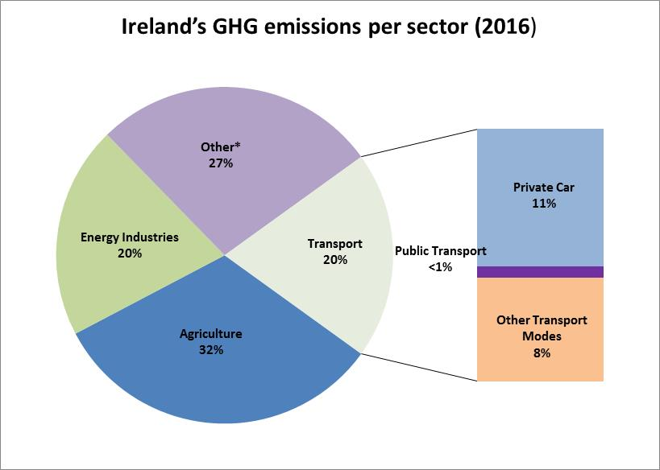
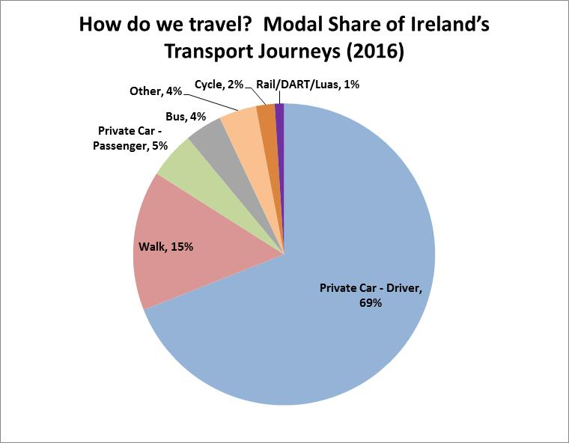
Challenges…

Slide 8
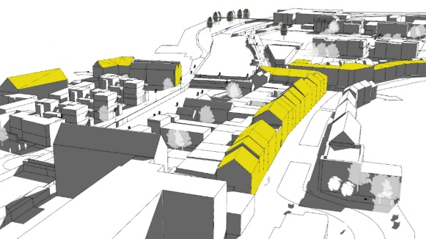
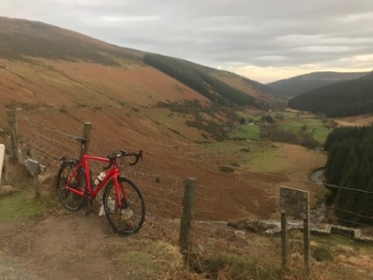
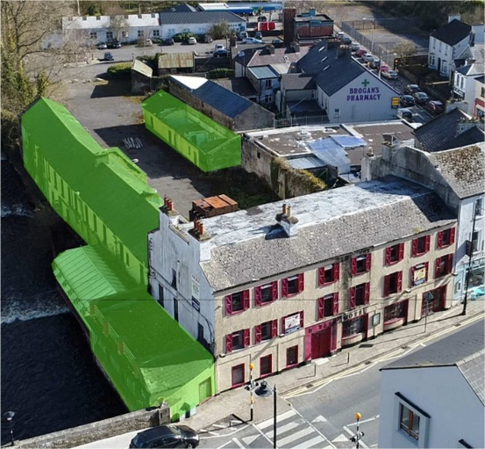
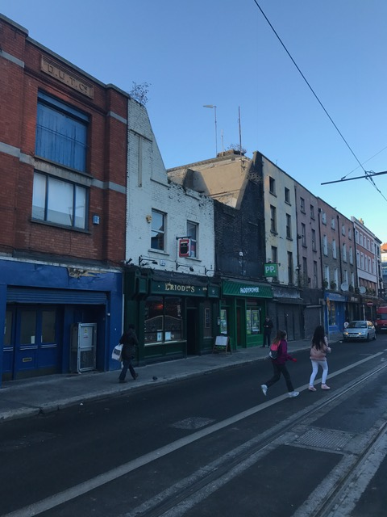
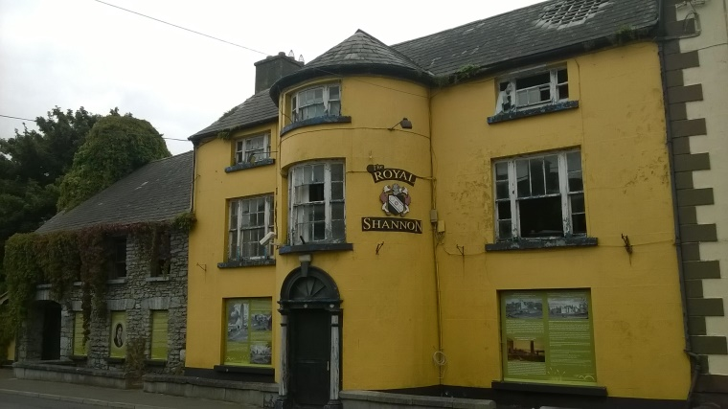
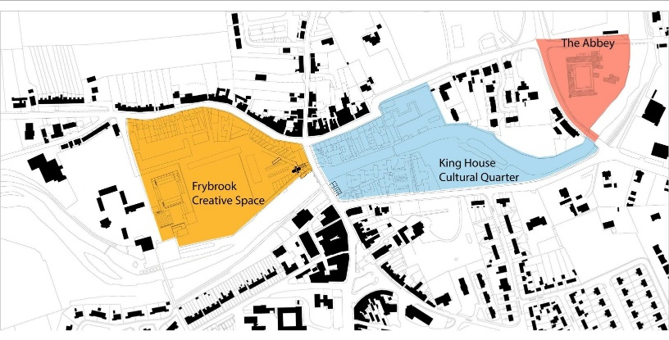
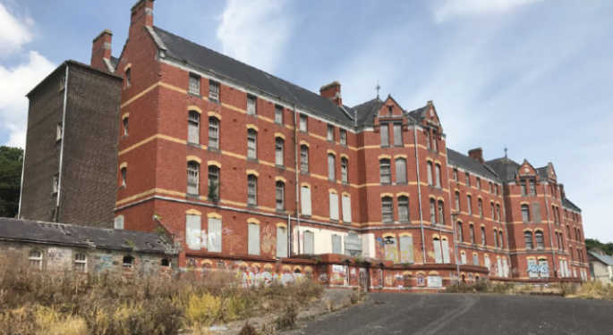
Opportunities

Slide 9
Purpose
Implementation of key recommendation of Mahon Tribunal to strengthen independent oversight of the planning process through:
(1) Assessment of statutory plans of local govt system for fit with statutory (Government/EU) policy and legislative requirements;
(2) Reviews and examinations of local authority and Bord Pleanála systems and procedures in the delivery of planning services to the public; and
(3) Building knowledge and information base in planning through training for LA members and staff, public information, research.

Slide 10
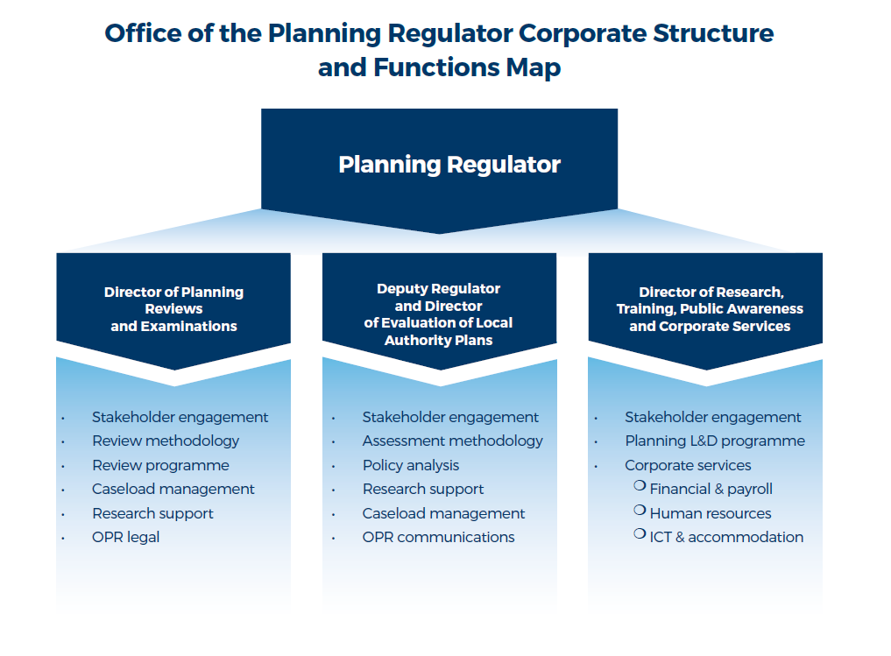
Structure
Located at 77 St John Rogerson’s Quay Dublin 2 – TUD Grangegorman (Q1 2020)
Contact
Phone: 01 553 0270 (9.30AM – 1PM and 2PM – 4PM)
Email: info@opr.ie
Website: www.opr.ie

Slide 11
Summary
Ireland’s planning process has come a long way in last decade…
Major strides in strengthening plan-making and implementation…
Enables shift of public engagement to plan making stage…
Oversight and governance structures will bed in…
Proper planning also needs effective and timely dispute resolution and enforcement mechanisms (Courts)

Slide 12
Thank You

