Slide 1

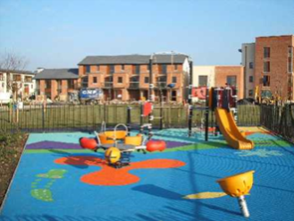
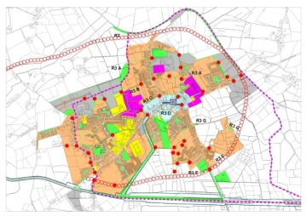
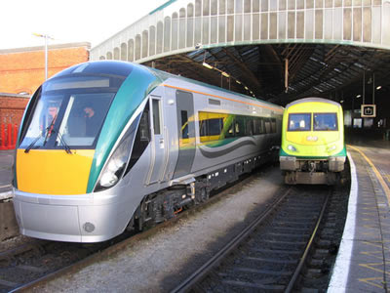
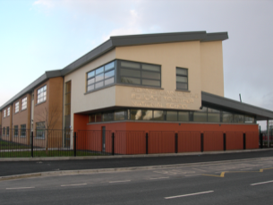
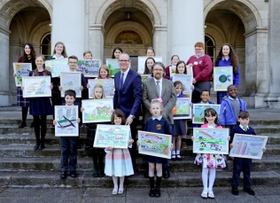
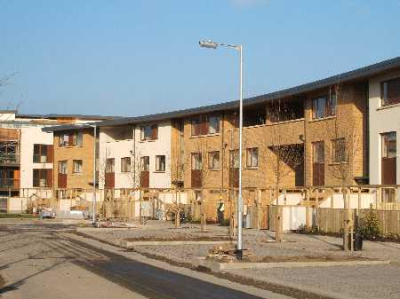
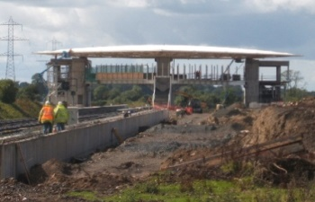
People – Places - Planning
Niall Cussen
Planning Regulator

Slide 2
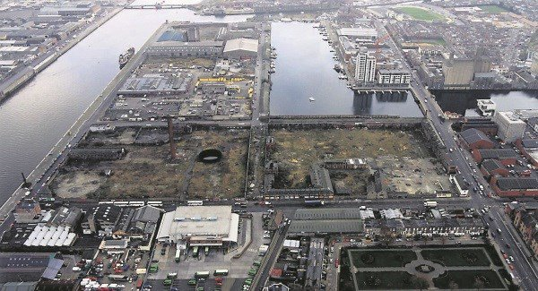
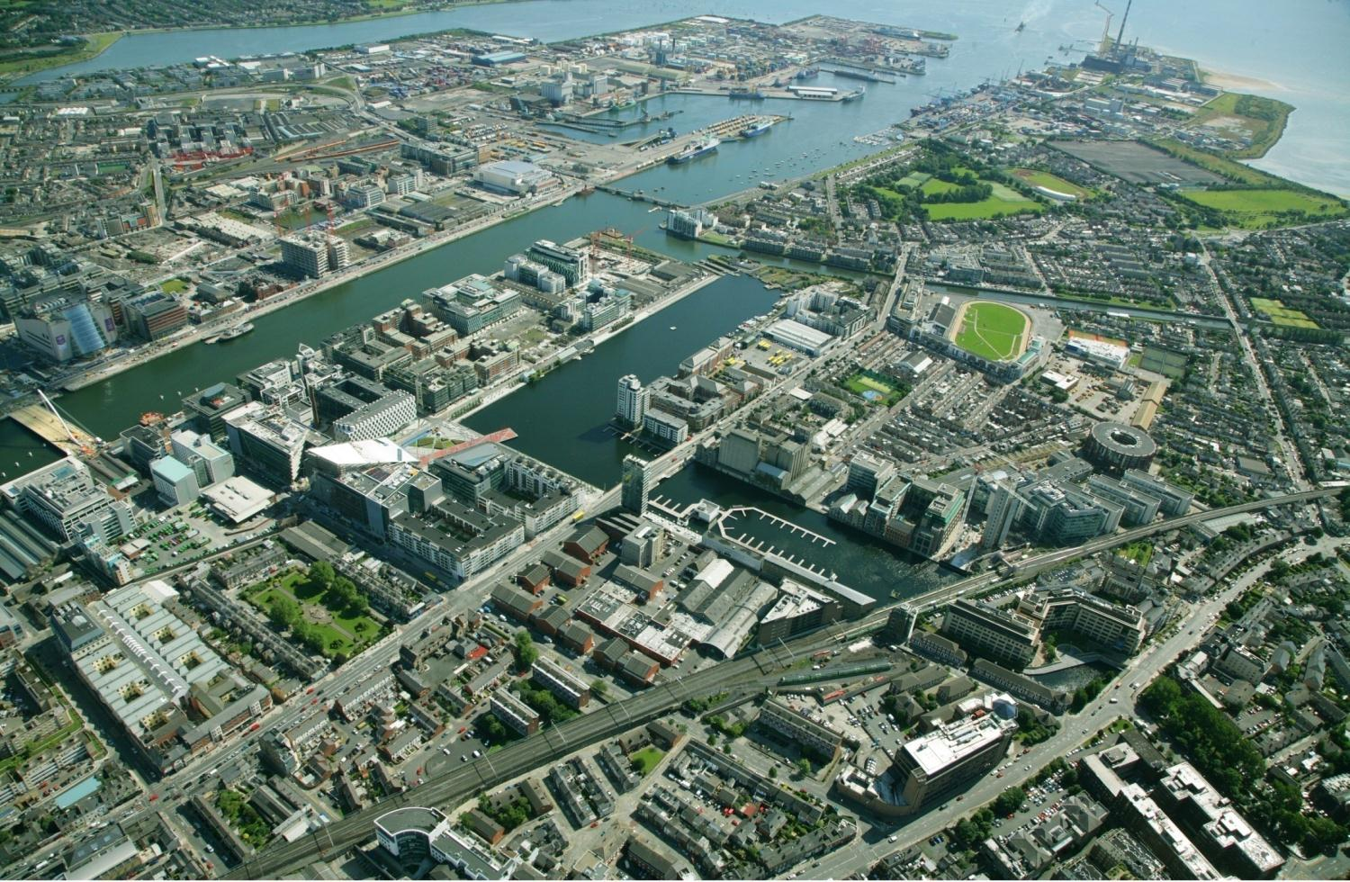
People - Place - Planning

Slide 3
Broadening Planning
Growing awareness of spatial/physical layout effects on our health and wellbeing.
NPF/NDP signal move away from “business-as-usual” urban sprawl.
Planning at local level must be more aware of addressing inequalities in quality of places from a health and wellbeing perspective.
Popularity of TV programmes like “Operation Transformation” signal societal wish for healthier living – BUT: driving to the gym?
People want to live closer to physical amenities, employment, cultural and heritage attractions - avoiding long car-based commutes - more time for families.
Higher densities – lower greenhouse gases (30%+ less??) from transport, heating – BUT!
Communities need to be at the centre of design – ensuring enhanced social interaction, integrating security and safety considerations (Commission on Future of Policing)

Slide 4
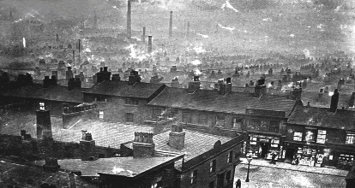
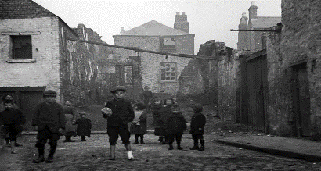
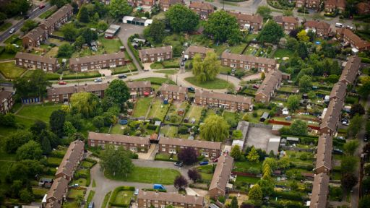
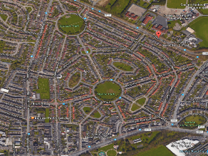
Déjà vu?
Origins of planning: health/environment/social crises…
Frederich Engels (1844) “The Condition of the Working Classes in England”
Benjamin Ward Richardson (1876) “Hygeia – City of Health”
Parks Movement (late19thC)
Ebenezer Howard (1902) “Garden Cities of Tomorrow”
Patrick Geddes (1904) “Eco-system based Urban Planning and Social Surveys”
Le Corbusier (1920’s) “Social Engineering”

Slide 5
Moving On…
Rigid zoning - reactive development management – scarcity of resources for plan-led development prevalent until relatively recent times.
Led to more development driven planning, which creates:
  (Roads) infrastructure led extensive development?
  Unhealthy/de-socialised environments?
  Erosion of ecosystems and green infrastructure
BUT!
People are seeking change – (evidence will drive further change)…
Move is on from “numbers based planning” to “place making/management”

Slide 6
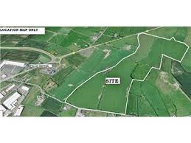
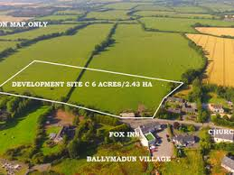
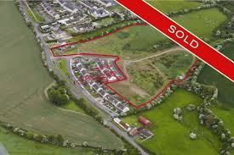
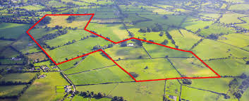
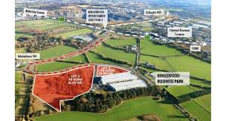
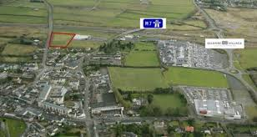
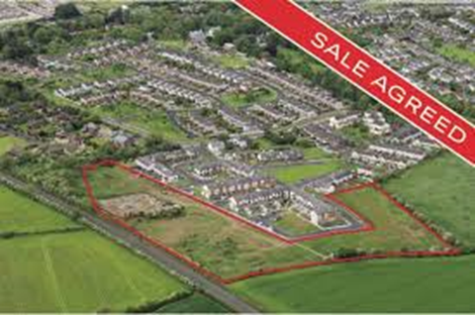
Past Focus For Planning?

Slide 7
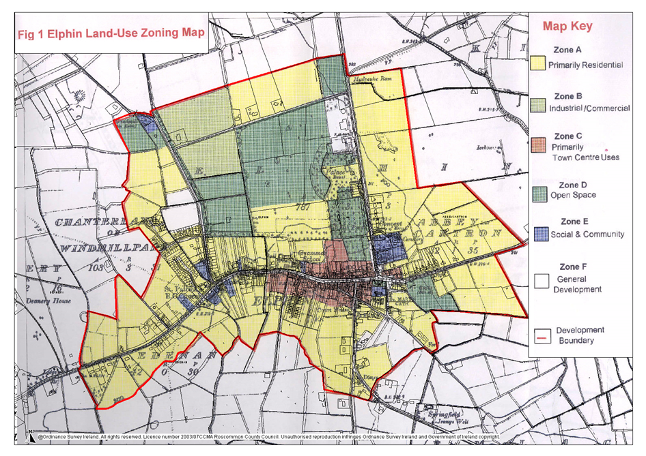
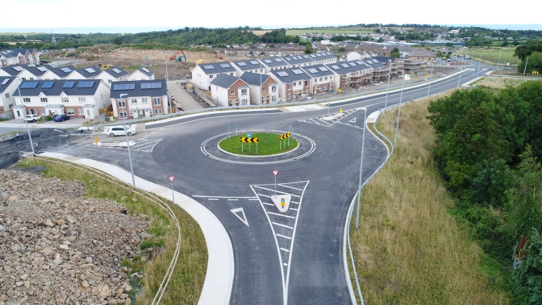
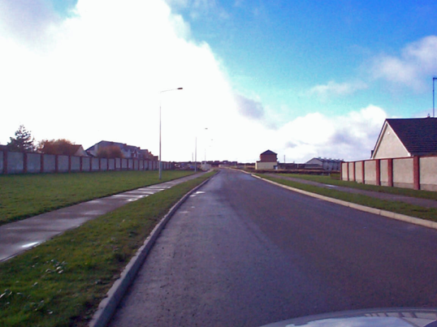
Losing Our Way…
Local Area Planning:100ha zoned residential 2004
2,000 homes +5,000 people?
Population in 2006: 590 Population in 2016: 565
Replicated many times over…

Slide 8
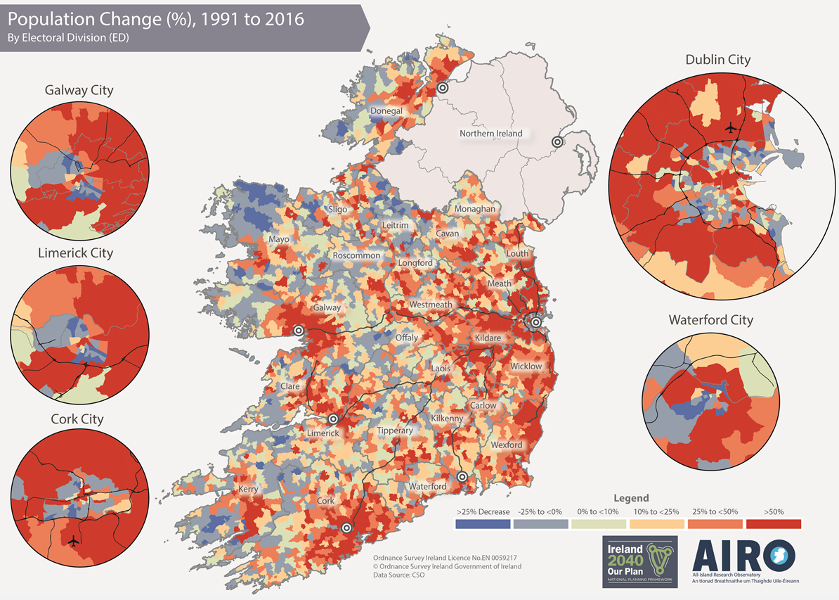
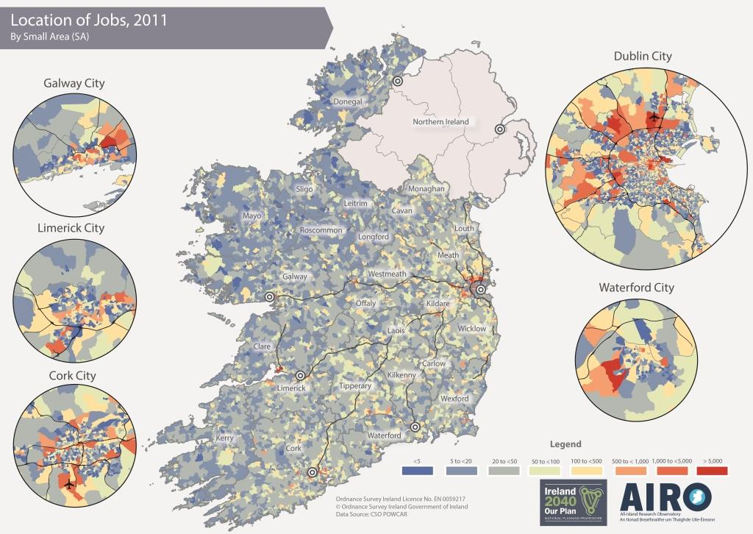
Living/Working Apart

Slide 9
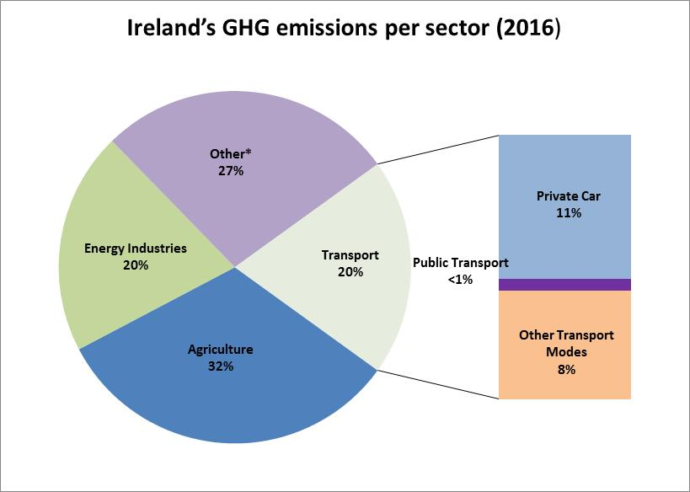
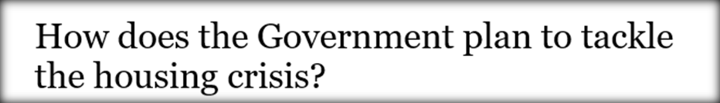
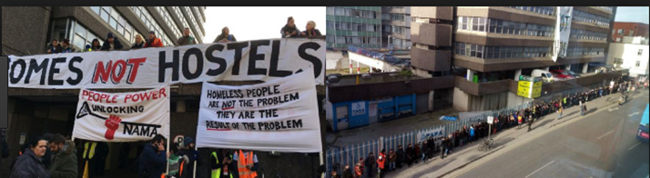
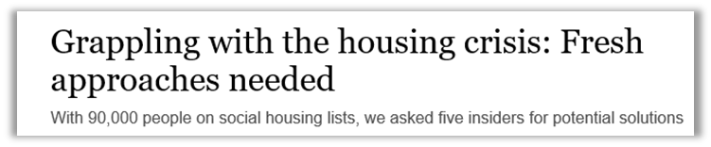
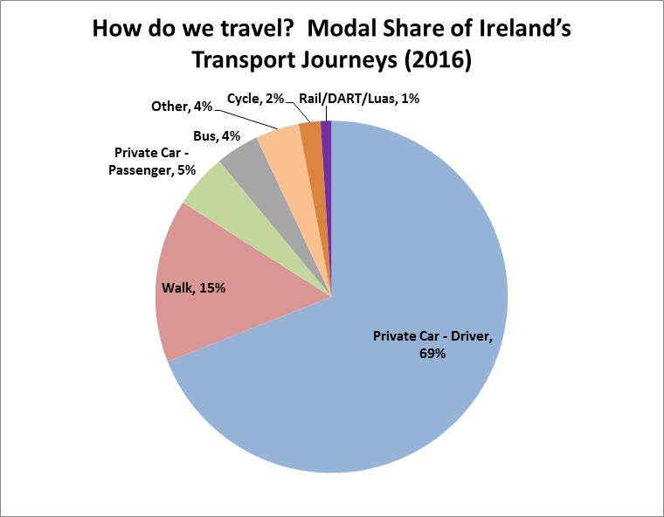

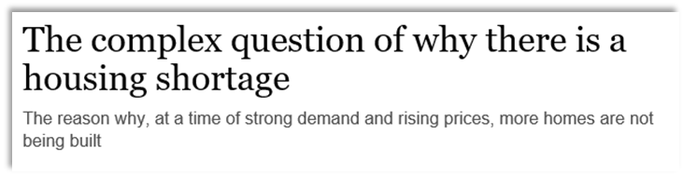
Challenges…

Slide 10
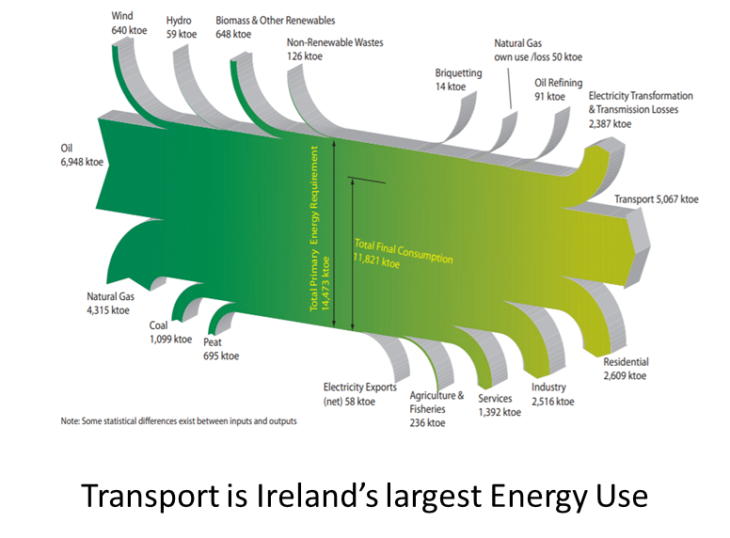
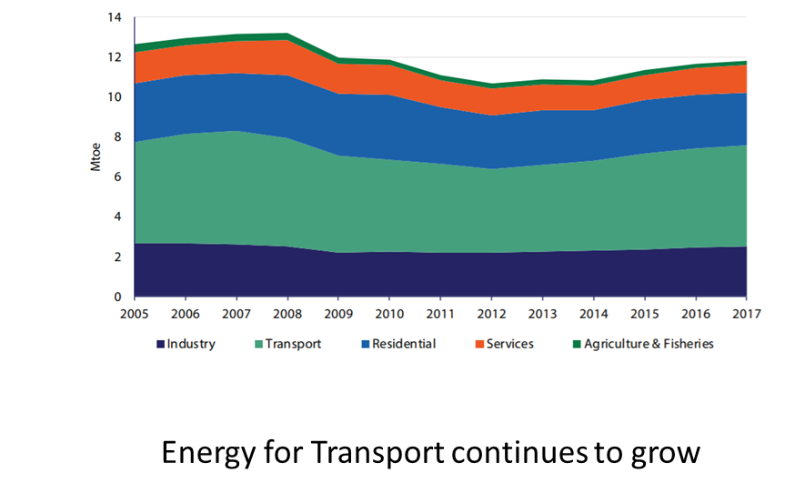
Trends

Slide 11
Change…
Project Ireland 2040 (NPF and NDP): Major policy shift – Compact Growth.
Driven by clear public voice that connected environment - health – planning.
People are understanding the links.
Now our turn to implement a more holistic – place and people centred approach to planning.
New governance/implementation mechanisms.
  Office of the Planning Regulator
  Land Development Agency
  National Development Plan Funds (x4)
Need for ongoing analysis – monitoring – feedback into public awareness and policy evolution

Slide 12
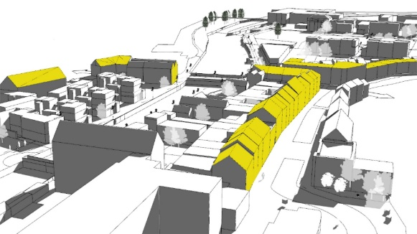
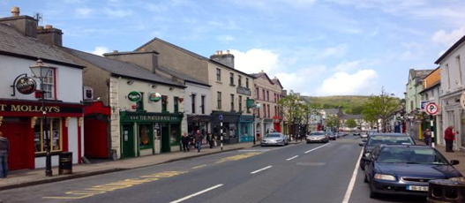
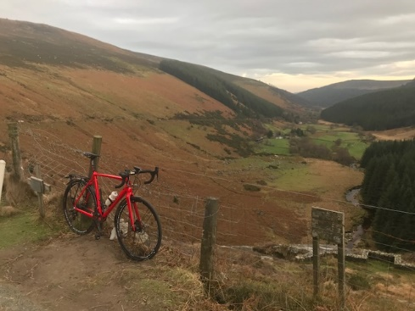
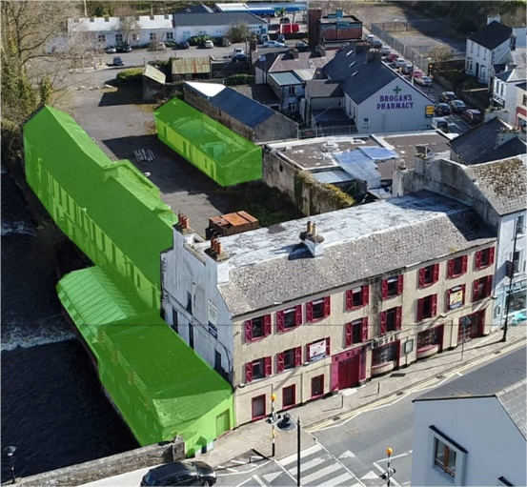
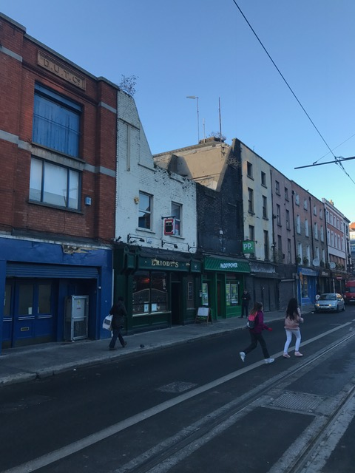
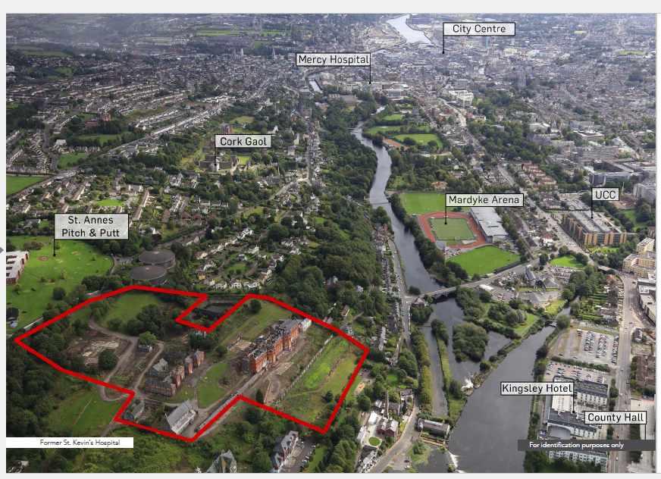
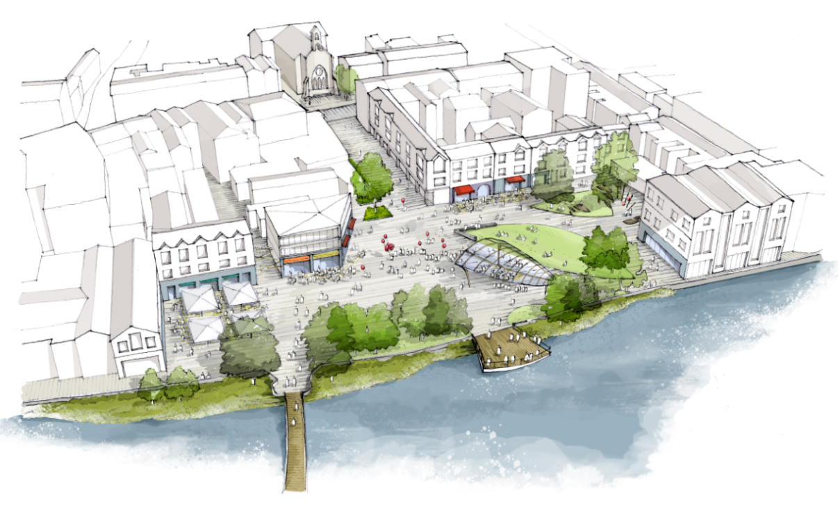
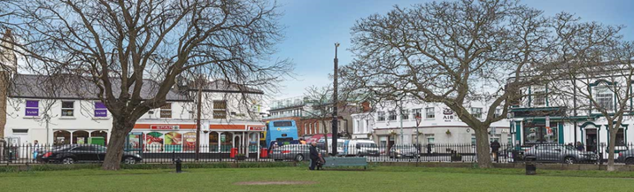
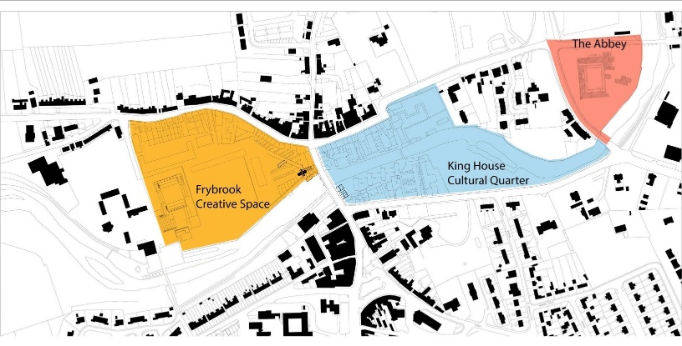
Focus Post NPF…

Slide 13
About Today
Highlighting the outputs from ESRI – EPA – DHPLG research collaboration.
  Gianluca Grilli (ESRI) Park attributes - visiting behaviour and health effects;
  Ronan Lyons (TCD) Value of green spaces in Ireland;
  Tom Gillespie (NUIG) Value of coastal views/proximity in Ireland; and
  Seán Lyons (ESRI) Relationship between rents and commuting distance.
Multi-disciplinary collaborative evidence based policy and implementation is key!
OPR statutory functions includes greater public awareness of planning – education – research.
Start of conversations today – where next? who should be listening next?

Slide 14
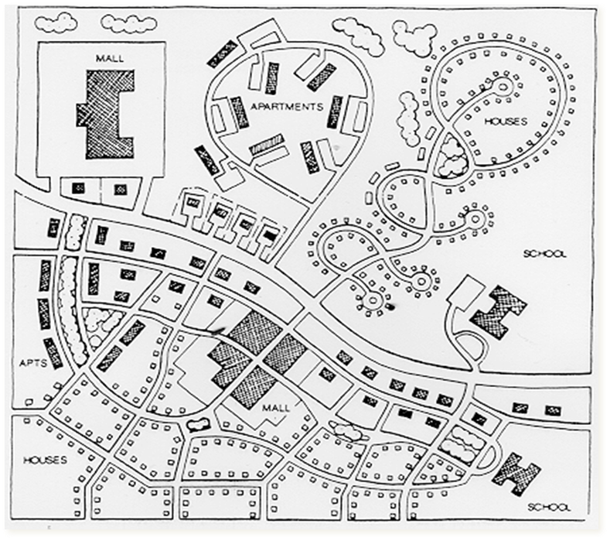

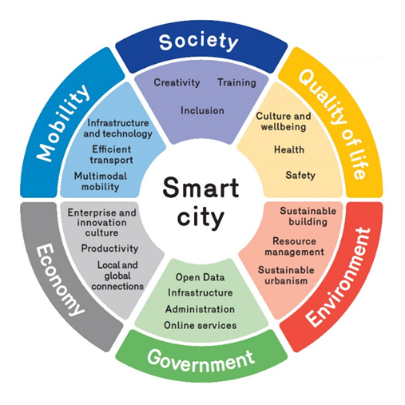
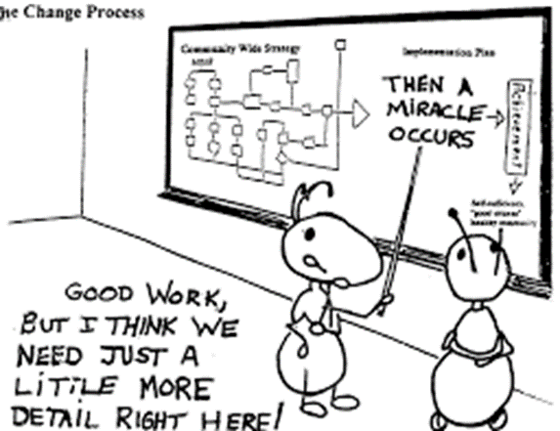
About OPR
Independent Statutory Office established April 2019 – 3 key functions:
  Assessment of statutory plans against strategic legislative and policy requirements
  Qualitative assessment of systems and procedures of planning authorities
  Promoting better knowledge/awareness/skillsets/research into future planning issues
Over 20 statutory plans assessed
200+ contacts from public re PA performance (most not within OPR remit)
Regional training seminars established
Year 1 objectives on staffing, premises and internal process near complete
Research/Education/Training activities program nearing finalisation

Slide 15
Thank You

